Slide 1
WW II Part 2
This Time Its Personal

Slide 2
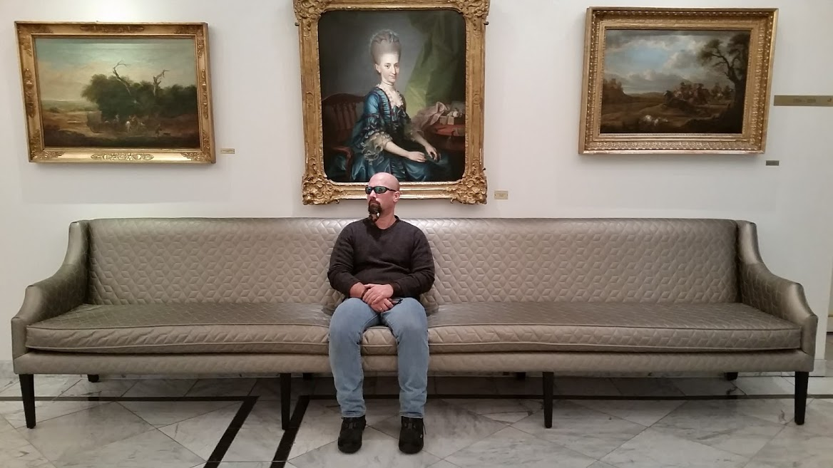
Isolationism
We hated WWI. So we didn’t want any more wars.
During the 1930’s many people believed that WWI was the fault of bankers and merchants that grew rich due to the conflict.
FALSE! Sort of. They did get rich, but the DID NOT START THE WAR!
When Japan invaded China in 1932 the reaction of the United States Secretary of State Henry Stimson was to not recognize the conflict.
So basically… “I see you are having a fight. If I don’t recognize your fight it will not be real.”

Slide 4
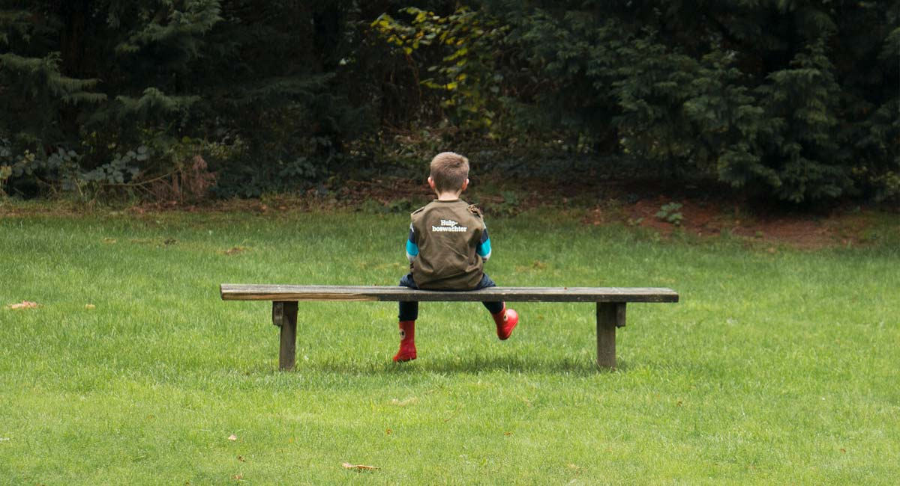
Isolationism Part 2
Roosevelt recognized the U.S.S.R. in 1932 (it’s not hard to recognize, its really big!)
We continued the Good Neighbor Policy (essentially we agreed to be nice to Latin American Countries. This didn’t last too long though…)
In 1934 Roosevelt pushed Congress to pass the Reciprocal Trade Agreement Act. This was meant to lower tariffs by up to 50%.

Slide 5
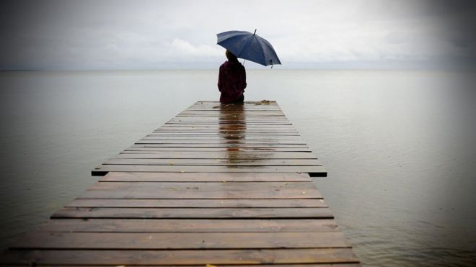
Isolationism Part 3
In 1934 Congress passed the Johnson Debt Default Act.
This made it impossible to give loans to countries that had not paid the U.S. back after WWI.
WE DID ARM CHINA…for awhile against the Japanese. Not explicitly. Remember we did not recognize the conflict. However since Japan had not declared war technically we could sell weapons to China.
Roosevelt also called on “Peace Loving” nations to quarantine aggressor nations.

Slide 6
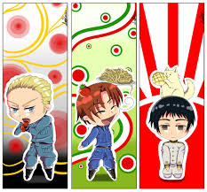
The Axis Threat
Cash and Carry
The Selective Training and Service Act
Roosevelt’s Third Term
Lend Lease

Slide 7
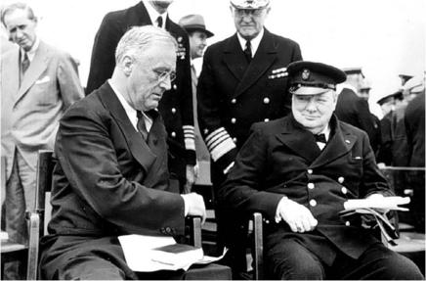
The Atlantic Charter
Churchill and Roosevelt meet secretly on a U.S. battleship in Canada
The Atlantic Charter is basically the beginning of the United Nations.
And now the countries standing up to the Axis powers would be known as the Allies.

Slide 8
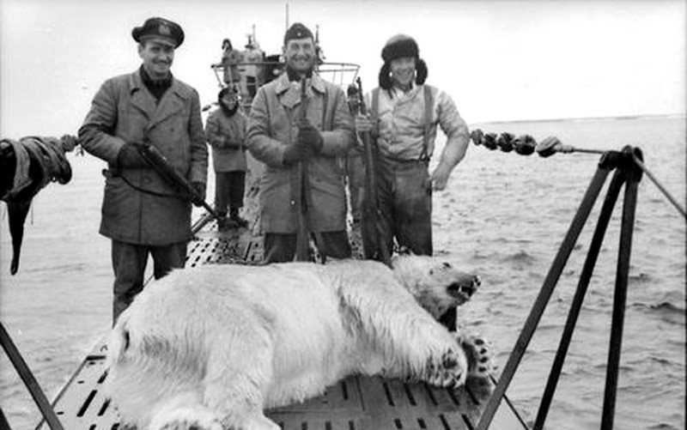
The Greer
The Greer was a U.S. destroyer fired upon by a German Submarine
Then the Nazis sank the Merchant Ship Pink Star off of Greenland
Next the Nazis sank the destroyer Kearny
The next ship attacked and sunk by Germany was Reuben James.
Roosevelt gave the orders that U.S. ships could defend themselves

Slide 9
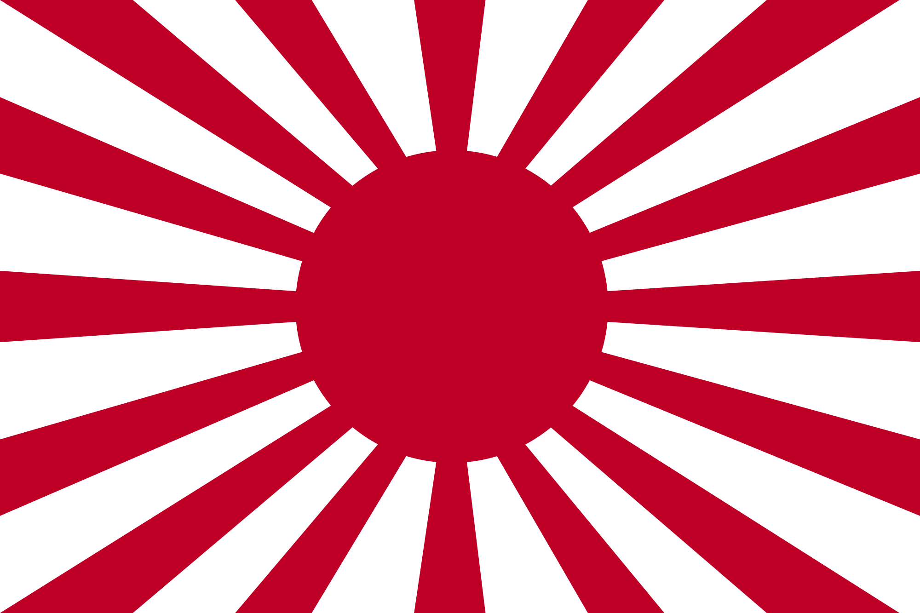
Japan Attacks The United States (of America)
Japan was pretty busy messing up Asia.
Japan was making moves to take European (mostly British and French) colonies in Asia.
The only real power in the area was the U.S. No U.S. territories were attacked however we were selling them oil and steel. Which they were using to wage attacks in Asia.
So we stopped. Japan had a choice to stop the attacks on Asia, capture Indonesian Oil fields or something else…

Slide 10
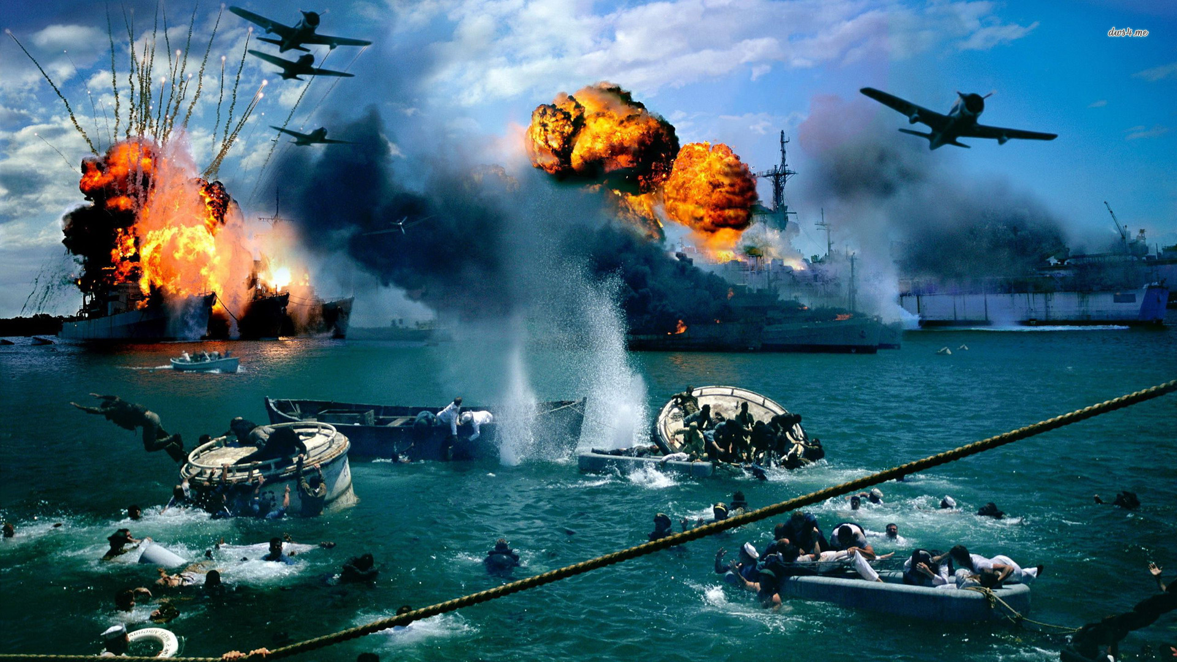
Pearl Harbor (soon)
We expected an attack.
Maybe Guam (home of the Guami Bears)
The Philippines
Or perhaps Hawaii (but that seemed like a long shot.)
On December 7th 1941 Japan attacked Pearl Harbor
It was all like “Boom! Kapow! “ etc.
Details…
Details…

Slide 11
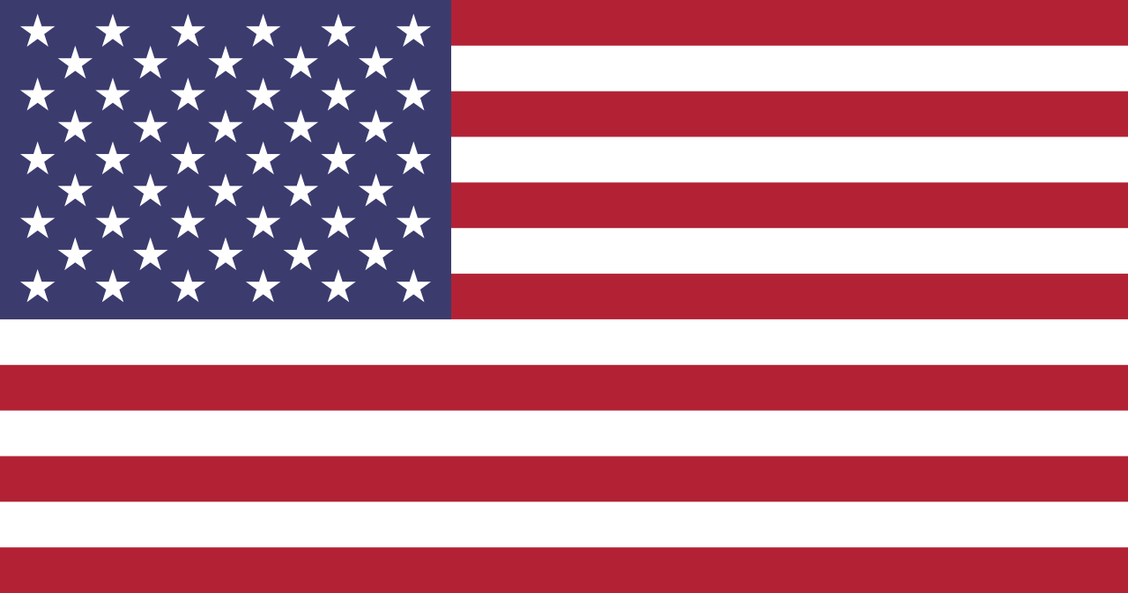
In the next installment…
Fighting the war
Winning the war
Being the best America Ever
Starting the Nuclear Age
The beginning of the Cold War

Slide 12
Vocabulary
Neutrality Acts
Axis Powers
Allied Powers
Selective Service and Training Act
Lend-Lease Act
Atlantic Charter
Splendiferous

