Slide 1
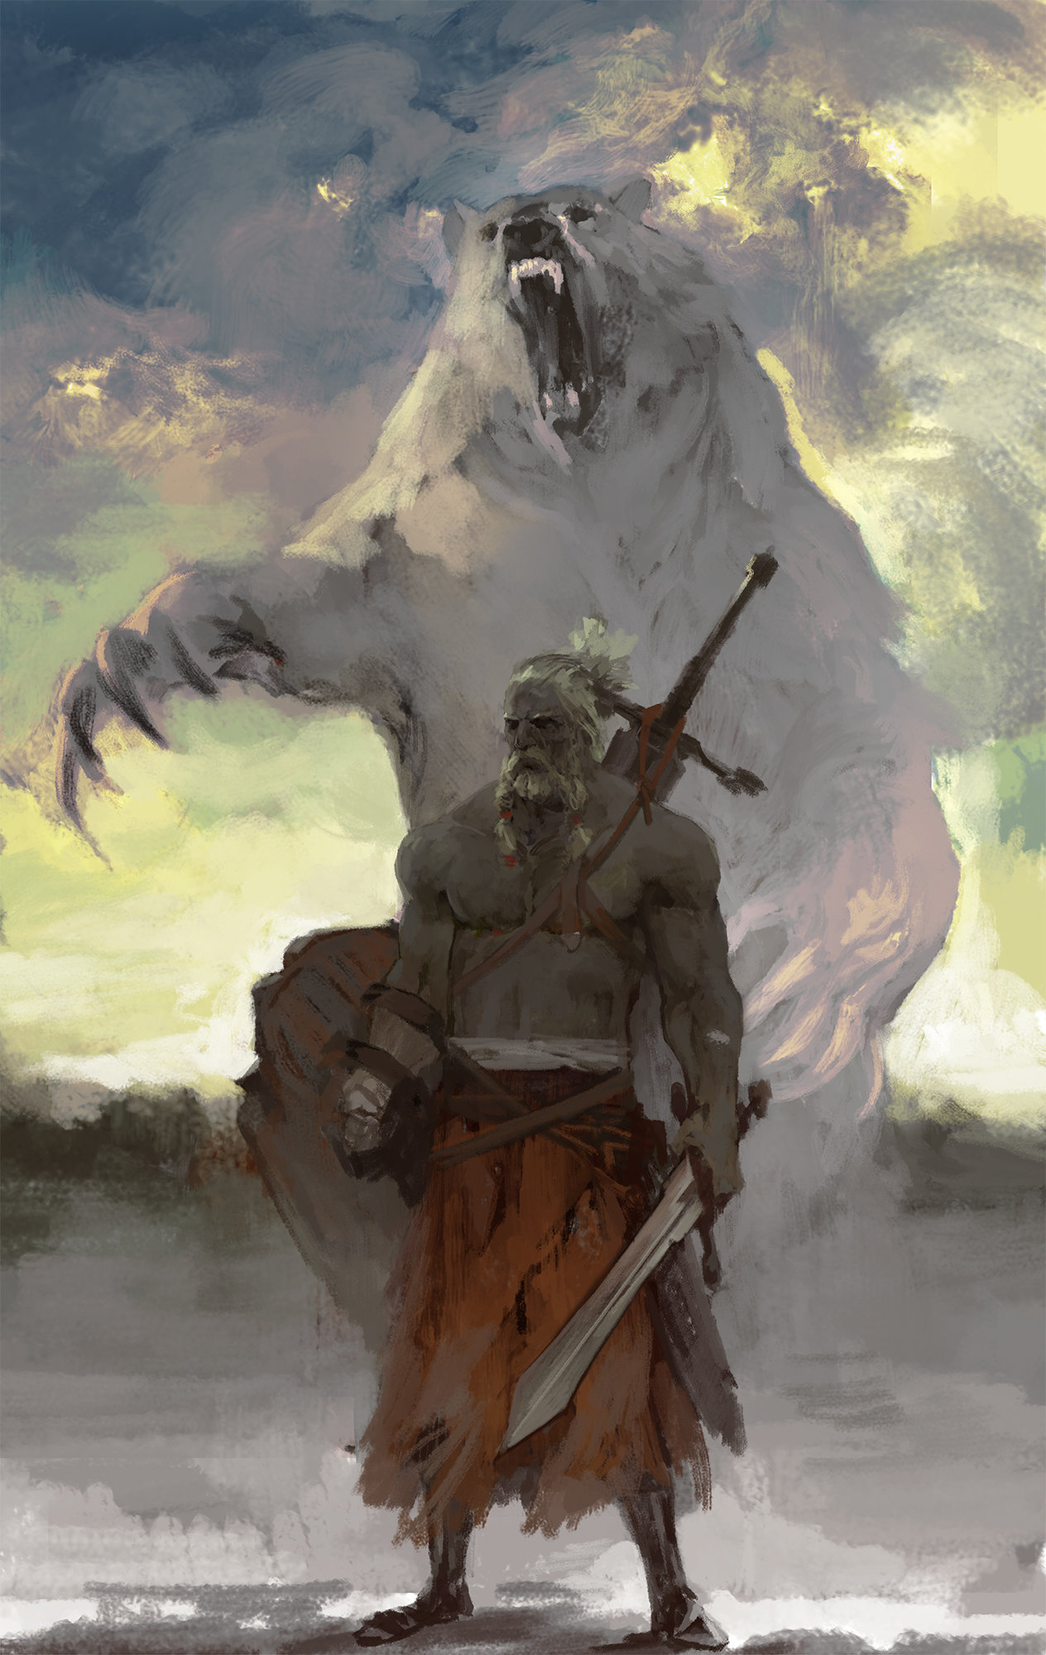
THE COLD WAR!
brrrr

Slide 2
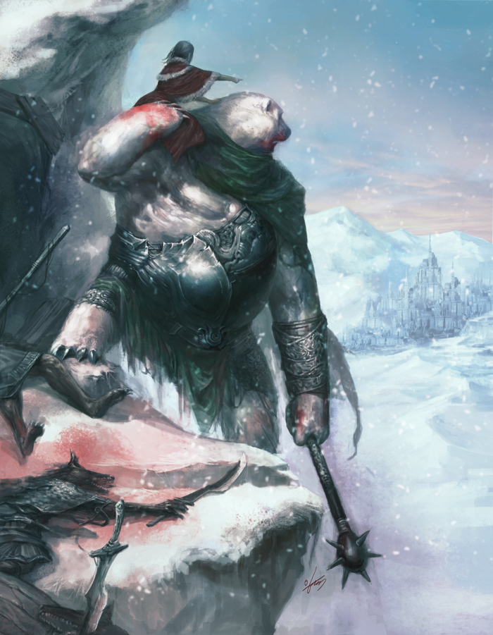
The Cold War
The cold war was fought for the domination of the Northern Wilderness. Two great armies of men and beasts clashed upon the tundra! Great Warriors rode astride polar bears wielding spears of clear ice and fought valiantly against the Walrus men of the Western Sea! Shields were shattered as the Polar Bear riders drove the Walrus men back to the sea but just as it seemed imminent that the Polar Bear riders would win dominion over the lands and seas of the Northern Coast a great warm wind blew across the pole and the seas melted and Polar Bear riders and Walrus men cried out together only to have their words quickly silences by the rushing salt sea. The first victims of the Cold War but certainly not the last!

Slide 3
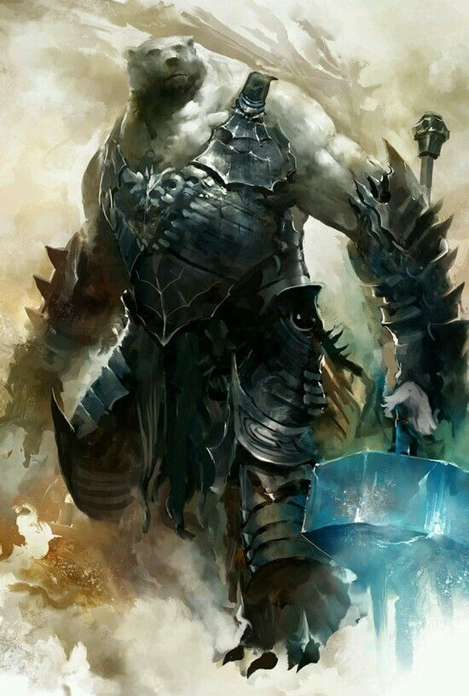
Not really.
Actually the cold war was the new world order that arose out of WWII.
The U.S. and U.K. represented democracy and self-determination.
The U.S.S.R. represented communism and authoritarianism.
The U.S. recognized the importance of capitalism while the U.S.S.R. represented something called a “command economy”
The U.S. and the U.K. were called the first world. The U.S.S.R. was the second world. Everyone else that was unaligned was the third world or potential client states.

Slide 4
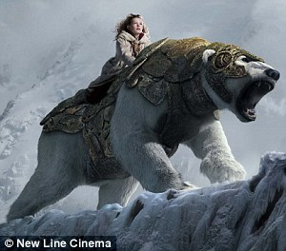
Soviets and Eastern Europe
The Soviet Union was concerned about invasions from the West. They felt that due to heavy casualties (20 million) and the threat of future conflicts they were entitled to control the countries of Eastern Europe.
The Soviets installed governments in Albania, Bulgaria, Czechoslovakia, Hungary, Romania and Poland. These were known as Satellite States.
In 1946 Stalin casually makes a speech claiming that communism and capitalism are incompatible. So…since there would inevitably be another war the Soviet Union would concentrate on making weapons.
Obviously the U.S. and everyone NOT Soviet considered this a threat.

Slide 5
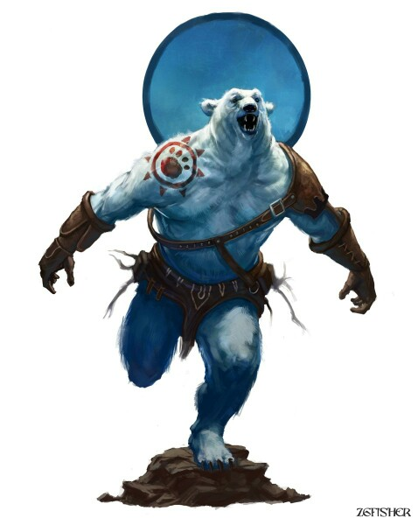
Iron Curtain
Go to Bed Bath and Beyond and ask for Iron Curtains. I dare you.
THE Iron Curtain was the term given to the divide between free Western Europe and Not-Free Eastern Europe.
The term was created by Winston Churchill. If you want to claim to have made it up yourself go ahead. No one will probably argue.

Slide 6
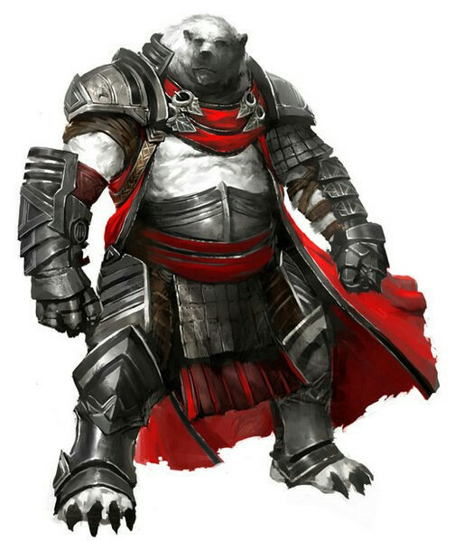
The United Nations
The United Nations was established in 1945
It is made up of numerous committees and represents approximately 192 countries.
It has two major parts. The Security Council and the General Assembly.
The Security Council is made up of the allies from WWII. Namely the U.S., The U.K., China, the Soviet Union and France.

Slide 7
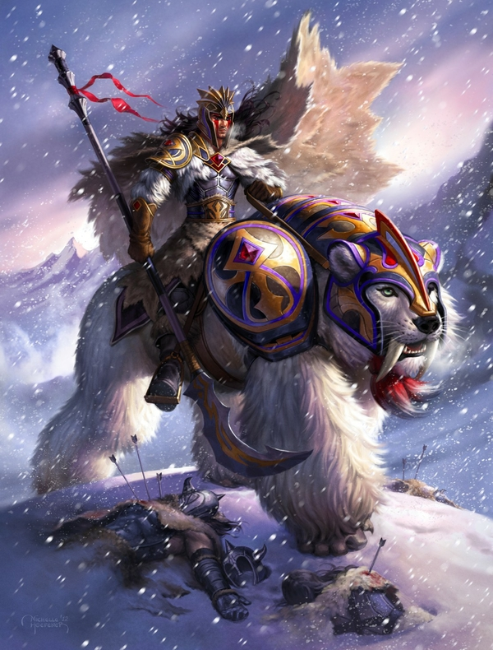
Containment
If the Soviet Union is openly expansionist, then the solution is simple. Contain the expansion of the Soviet Union.
The credit for this policy is usually given to George F. Kennan, but it is a reflection of something called the Rimland theory by Nicholas Spykman.

Slide 8
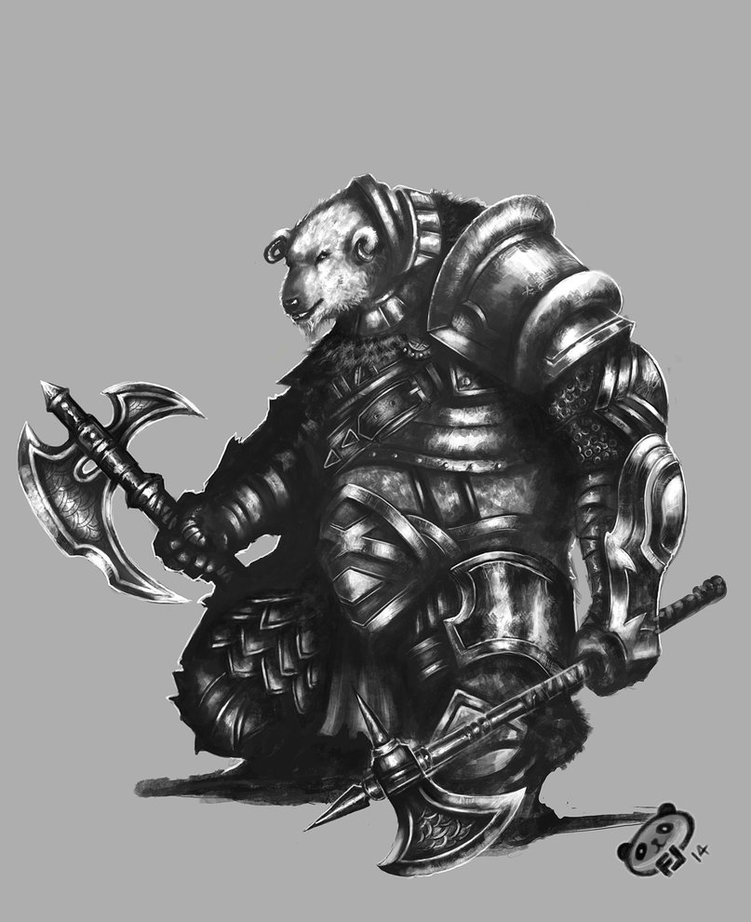
Policies of the Cold War
The Truman Doctrine-Money for governments fighting against communism-400 million dollars mainly to Turkey and Greece
The Marshall Plan-Money to rebuild and keep Europe from starving. But only if they promised to work together. This would eventually help lead to the European Union. 13 billion dollars.

Slide 9
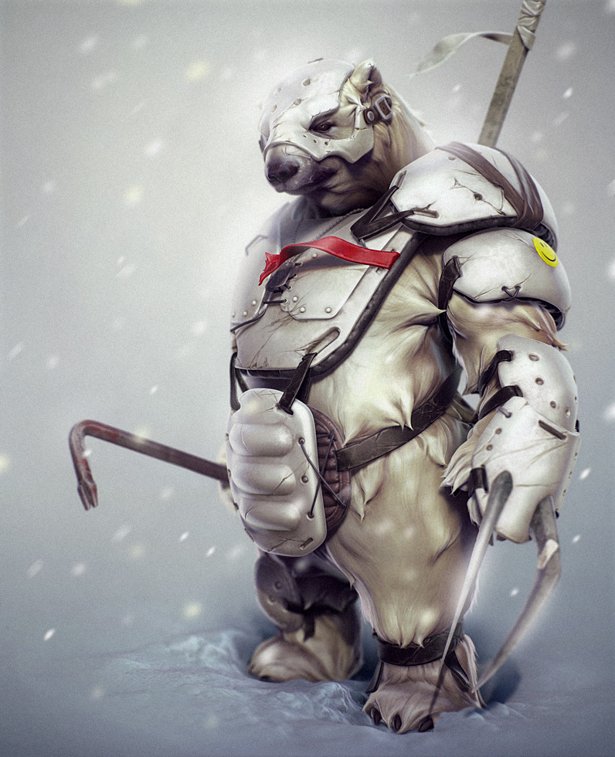
The Berlin Airlift
In 1948 the British, Americans and the French agreed to combine the three parts of Germany they controlled individually into one country.
There was no provision that the Soviets had to allow passage into through East Germany so they blockaded entry through East Germany cutting off access to West Berlin.
The 2.1 million people living there had enough food for about five weeks.
For 327 days the U.S. and British airlifted food, fuel, gifts etc. into Berlin. Back then we didn’t do the whole “America First” bullshit. We actually cared about the community of nations.
As a result of this the Soviets backed down and lost prestige while the U.S. gained prestige.

Slide 10
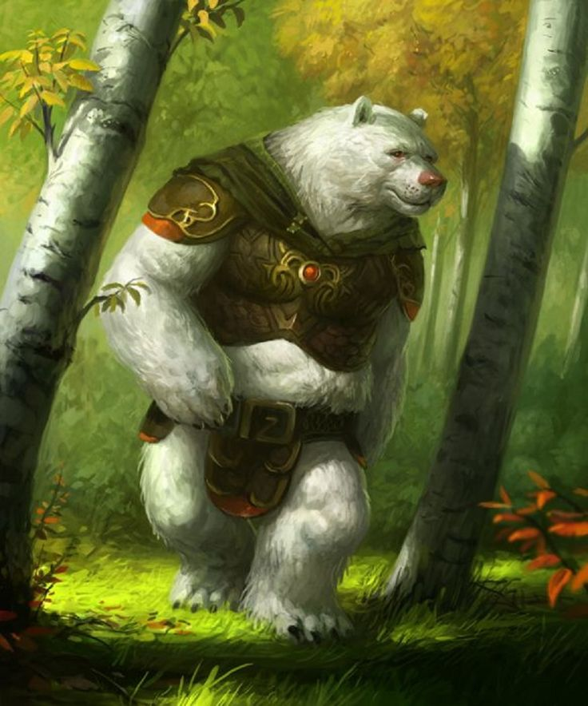
NATO
NATO stands for North Atlantic Treaty Organization
It is a Supranational organization with the goal of keeping the former Soviet Union and the current Russian Federation from expanding.
The original members were Belgium, Denmark, France, The U.K., Iceland, Italy, Luxembourg, the Netherlands, Norway, Portugal, The U.S. and Canada.
This was the first time in U.S. history that the U.S. had entered into a military alliance during peacetime.

