Slide 1
Population
And so Begins Unit 2
Keep These Notes in the Population Section of Your Notes

Slide 2
Where In The World Do People Live and Why?
Geographers study population traits across space.
Demography is the study of population.
Demographers report the population density of a country as a measure of total population relative to land size.

Slide 3
United States
The Arithmetic Population Density of the U.S. is 81 per square mile.
So where is everybody?

Slide 4
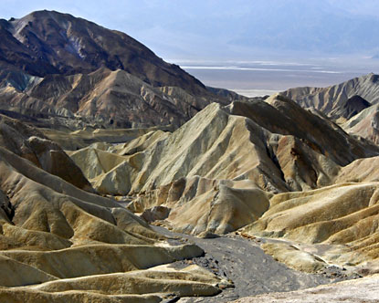
Not Here

Slide 5
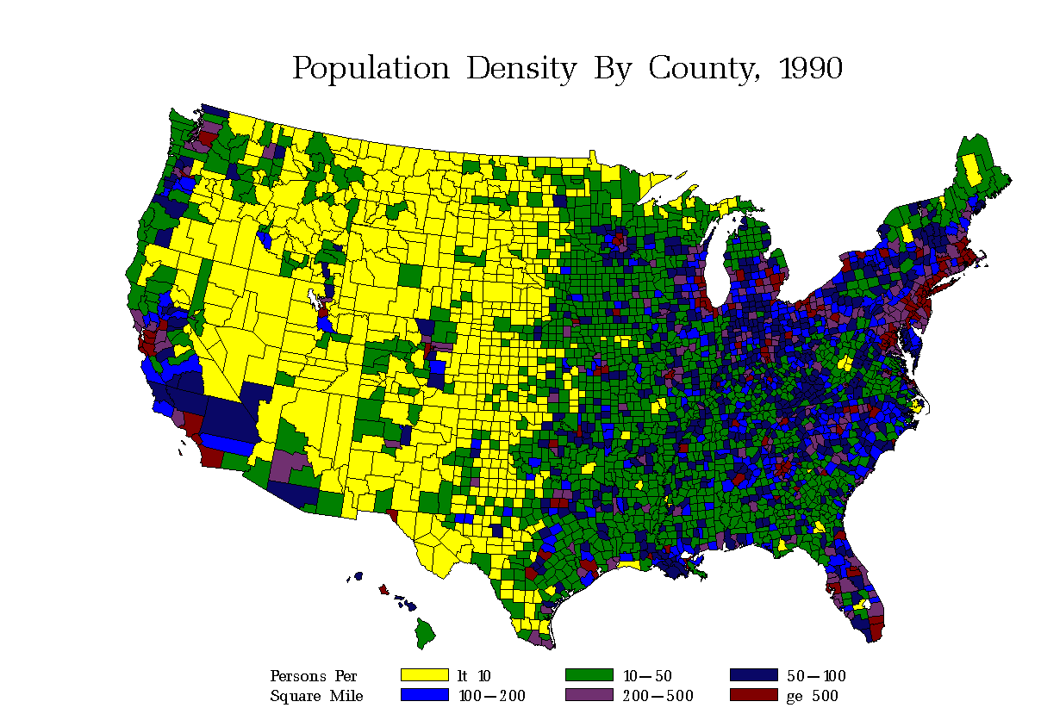
Population Density of the United States

Slide 6
Arithmetic Population Density
Um…It’s the same as just plain population density. Just averaged. Basically the average amount of people per square mile or kilometer.

Slide 7
Population Density
The arithmetic population density of Egypt is 203 per square mile.
This is relatively low. So, how do you explain pictures like this?

Slide 8
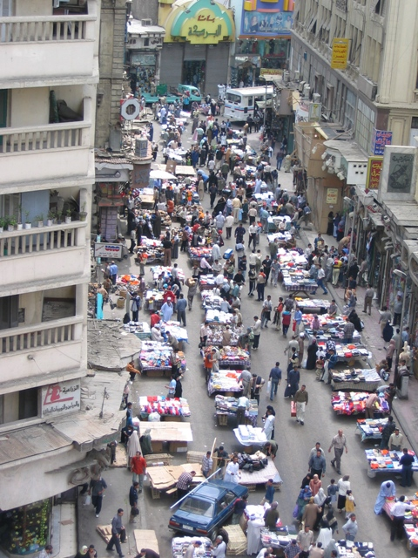
Egyptian Street (Souk)

Slide 9
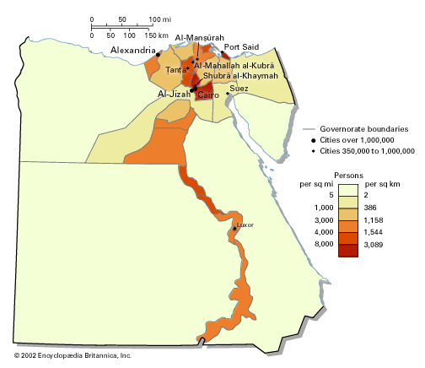
Population Density of Egypt

Slide 10
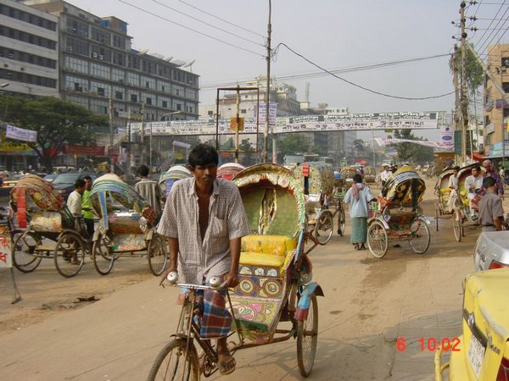
Bangladesh

Slide 11
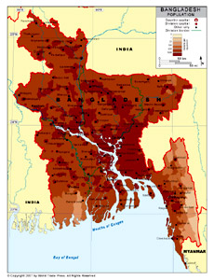
Bangladesh
Arithmetic Density is 2738 per square mile

Slide 12
So…Arithmetic may be misleading. Is that all we have? Please say we have more choices!
Yes. We have physiologic population density.
This relates the total population of a country or region to an area of arable land.
What’s arable?
Ok, Kyleigh. It means you can farm it.
I wasn’t going to ask.
Yes you were.

Slide 13
Egypt Part II
When you take into account the physiologic density you end up with this.
6776 people per square mile. This takes into account the people that live in the Nile Valley and Delta.

Slide 14
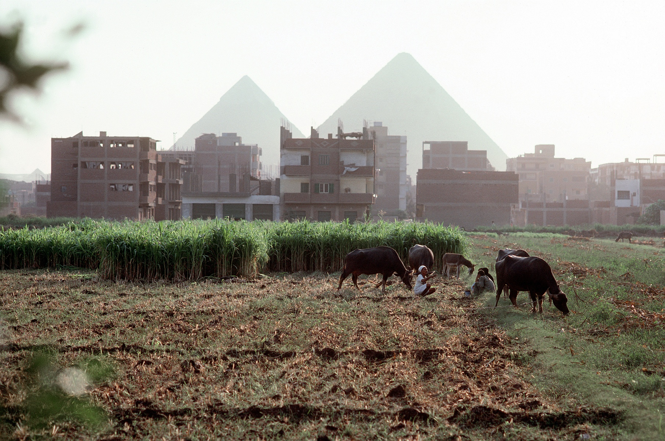
Egyptians Farming

Slide 15
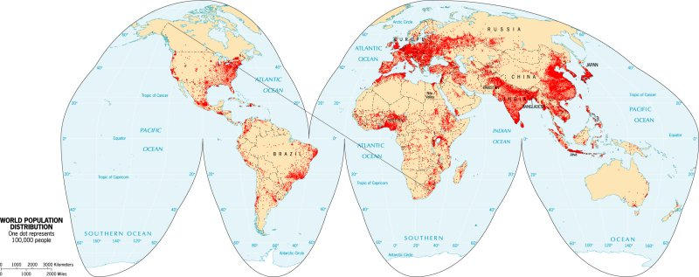
Population Distribution Displayed as Dot Map

