Slide 1
Hooray! It’s a Power Point!
Please clap loudly and pretend to be excited. Thank you. This is all I have.

Slide 2
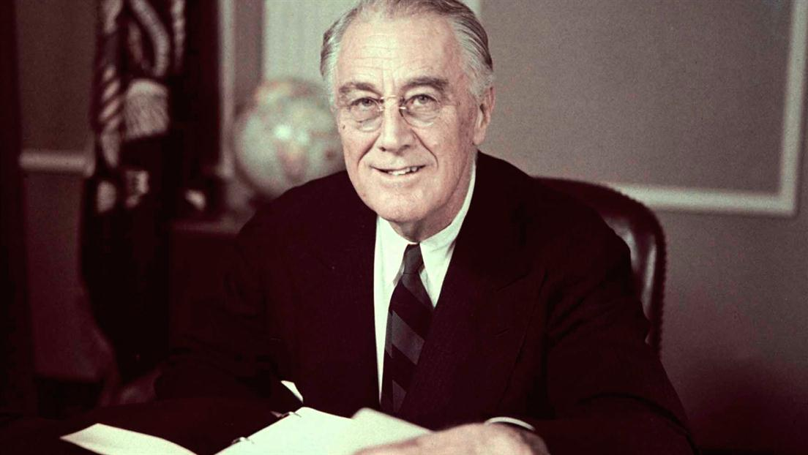
The New Deal!
The New Deal was Franklin Delano Roosevelts plan to end the Great Depression.
The Great Depression is an oxymoron. I thought I should point that out.
The New Deal was new because the Old Deal was to literally do nothing about the economy and hope that worked.
Also when I was in elementary school I went on a field trip to F.D.R.’s house.
I guess that last bullet didn’t matter.
Someone probably wrote it down anyway.

Slide 3

FDR
FDR was elected in 1932 because Herbert Hoover had personally eaten everyone’s favorite pet and smashed all of their windows.
What I said about Hoover is not remotely true, but even so he was tremendously unpopular. I guess you know how that feels, don’t you?
At any rate FDR was pretty popular. He had served two terms as the Governor of New York. He was also related to Theodore Roosevelt. Speaking of related he was married to his cousin Eleanor but that probably didn’t matter that much because she probably wasn’t that into him anyway. Also he had a mistress. That is all true, but it doesn’t matter that much.

Slide 4
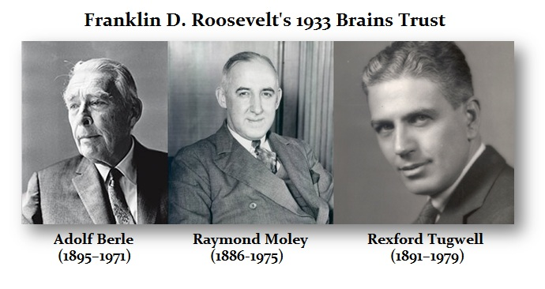
The Brain Trust
FDR didn’t take office until March because it was only after the 20th amendment that Presidents took office in January. In the meantime he began assembling a cabinet that was full of professors, lawyers and journalists.
This became known as the Brain Trust and together they created a three part plan. You will need to know this three part plan so pay attention.
The New Deal would focus on three goals:
Relief for the Needy
Economic Recovery
Financial Reform

Slide 5
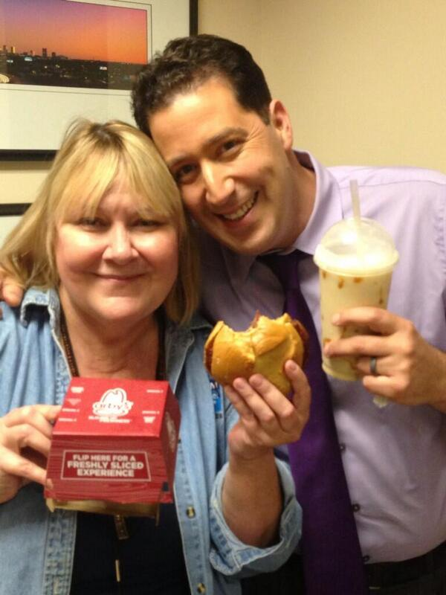
The Hundred Days (Warning: Each bullet point in this slide will have an unnecessary simile.)
From March 9th to June 16th 1933 the President focused on passing legislation like a fevered beaver.
The role of the federal government was strengthened like a moose on steroids.
Roosevelts first step was to create a bank holiday. (He was in a wheel chair and I found this sentence in your book to be as tasteless as a first date at Arby’s. No offence, I’m sure some people like Arby’s.)
The bank holiday meant that the banks would be closed until legislation could be passed to restore confidence, a move as necessary as a fedora at a gaming convention.

Slide 6
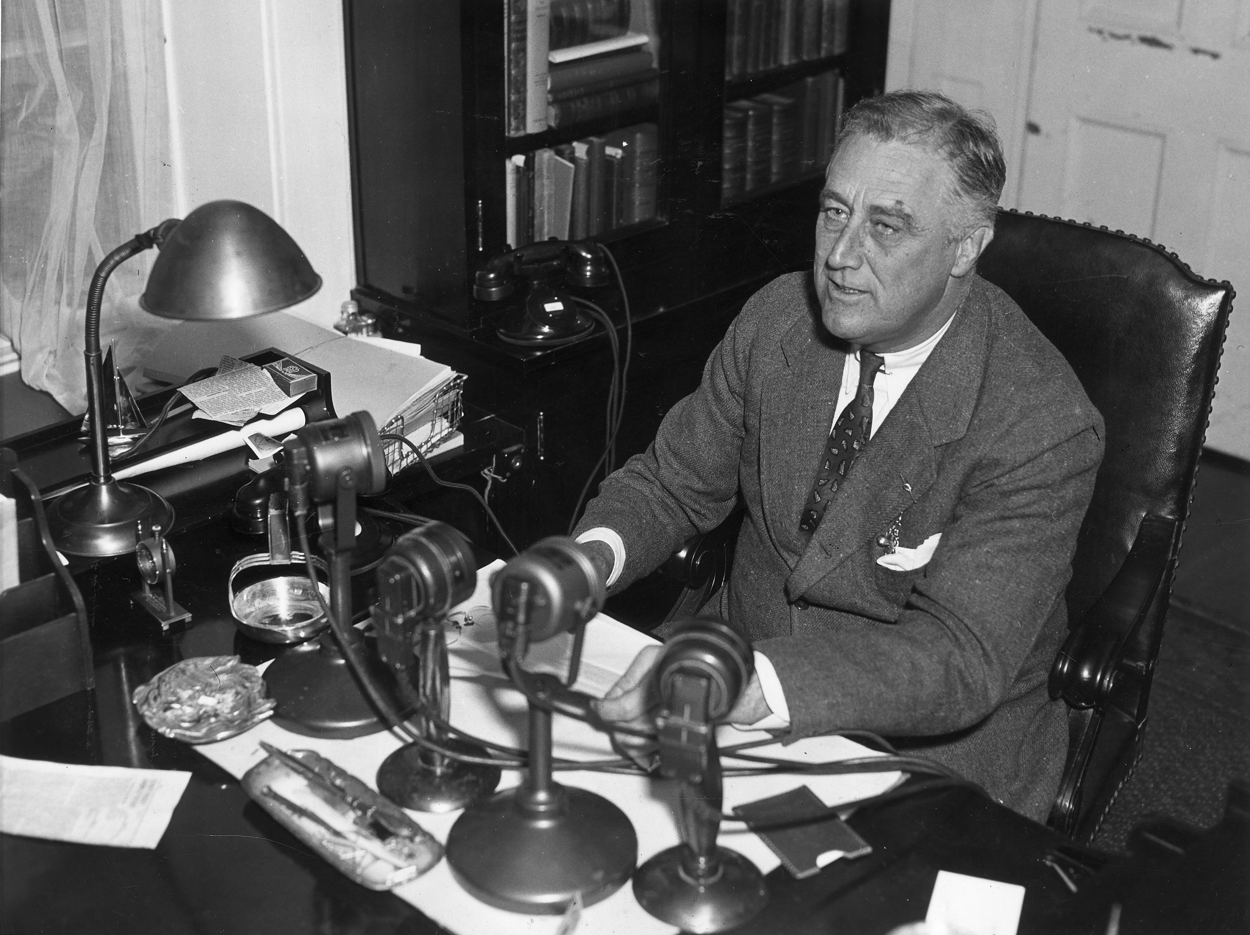

Roosevelt and the Fireside Chat
Roosevelt was one of the first President’s to make use of Mass Media. At the time it was seen as a good thing and made him progressive but I think we all know where this will lead…
Roosevelt called his radio addresses fireside chats and they ended abruptly when he sat too close to the fire and burst into flames, all the while screaming over the radio “Ow, I’m on fire! This really hurts!”
That is not remotely true. His fireside chats were pretty beloved and he was one of the first presidents to speak directly to the people.

Slide 7
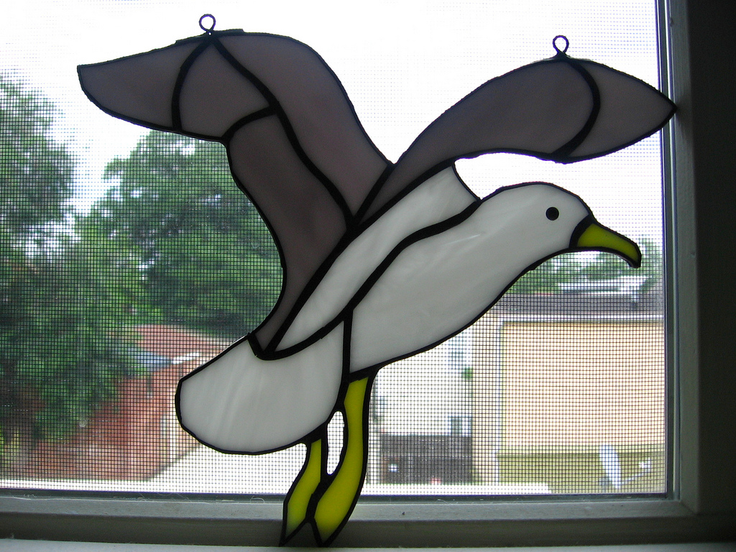
Regulating Banking and Finance
FDR regulated banking and finance. He did it with such legislation as:
The Glass Steagall Act of 1933 (FDIC)
The Federal Securities Act (SEC)
He also passed a bill allowing the sale of some low alcohol beer. It gets lumped in here because it was meant to stimulate the economy.

Slide 8
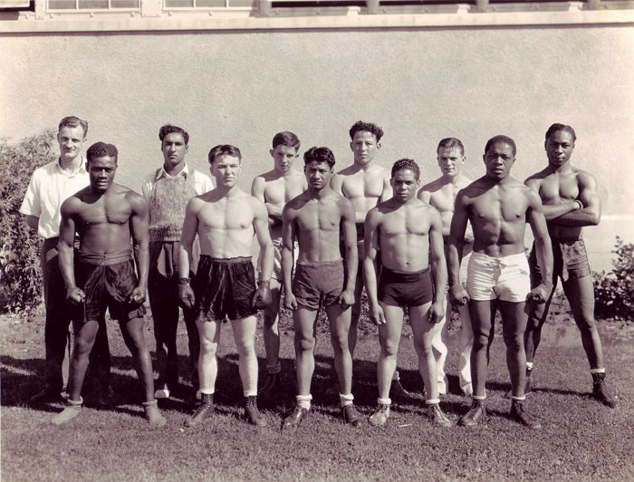
Helping the American People
He attempted to create rural assistance with the Agricultural Adjustment Act (AAA) This did not go over well.
The Tennessee Valley Authority (TVA)
The Civil Conservation Corps (CCC)

Slide 9
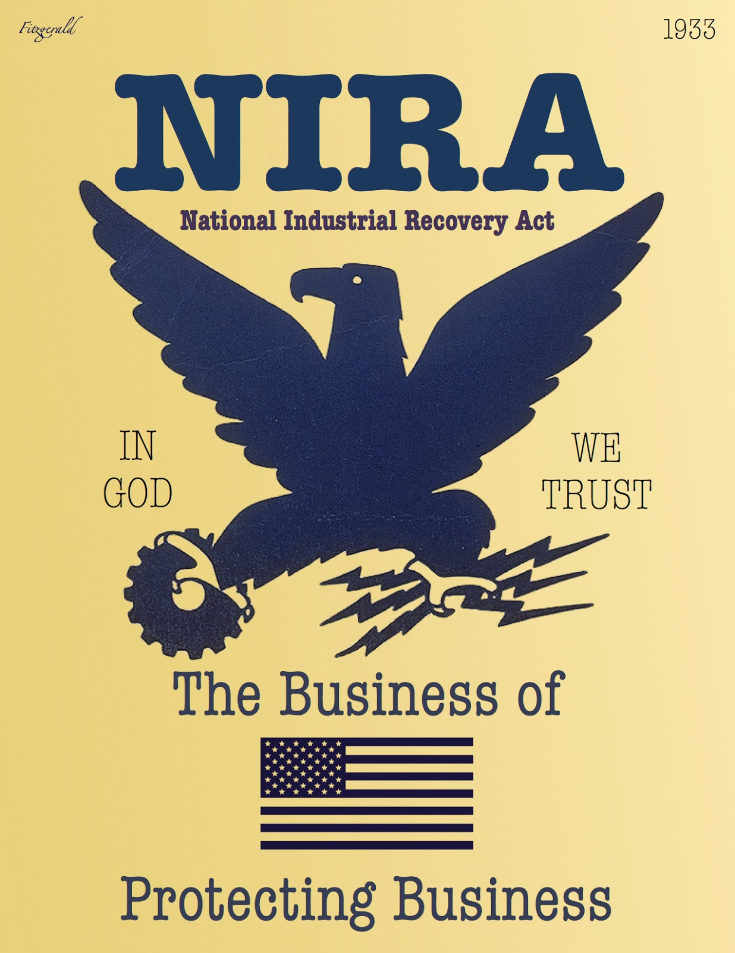
Providing Work Projects
See CCC on last slide. Also:
National Industrial Recovery Act (NIRA)

Slide 10
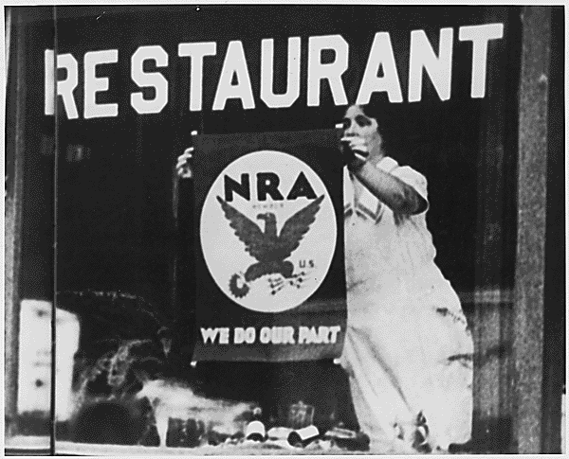
Promoting Fair Practices
National Recovery Administration (NRA)
Just so you know this is not the same NRA that thinks you should never leave the house without a rocket launcher and a shotgun. It’s a different NRA.

Slide 11
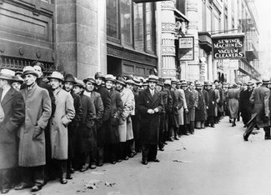
Food, Clothing and Shelter
The Home Owners Loan Corporation (HOLC)
And let’s not forget the Federal Emergency Relief Administration (FERA)

Slide 12
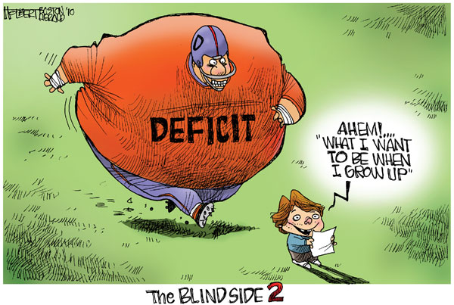
Deficit Spending
This was literally the government spending more than it had. Of course this meant going into debt. However if the government went into debt on your behalf, you end up with more money of your own not being spent (for awhile at least).
This created confidence but was done reluctantly by Roosevelt.
Of course all of this legislation would have critics. Many of the policies of Roosevelt were shot down by the Supreme Court after being criticized by conservatives .

Slide 13
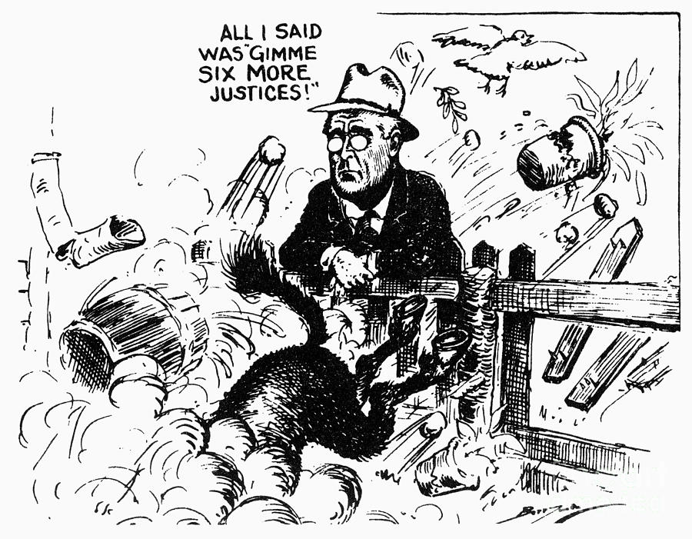
The Problem of the Supreme Court
In order to get new and more liberal justices on the Supreme Court Roosevelt suggested a Constitutional Amendment to add six new justices making the total number 15.
This did not go well. Not even a little well. Not at all. People hated this idea.
So instead he offered full salaries to any Supreme Court Justice that would agree to retire. This worked.

Slide 14
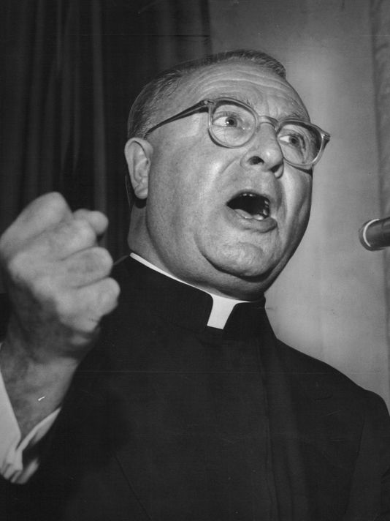
Critics of Roosevelt
The following were (are) fierce critics of Roosevelt:
Father Charles Coughlin: He favored a guaranteed income and the nationalization of the banks. He eventually fell out of popularity because he blamed all of America’s problems on the Jews and that was not ok.
Dr. Francis Townsend: He wanted to pay the elderly for being old but the plan would bankrupt the U.S. if put in place. He had the support of the elderly (of course.)
Huey Long: He created the very popular Share Our Wealth program. People liked it and it was very popular. He was running for President against Roosevelt with this program as his platform, but he was assassinated.
Leonardo Gonzalez: He just likes to be difficult. Also he hates big government whatever that means.

