Slide 1
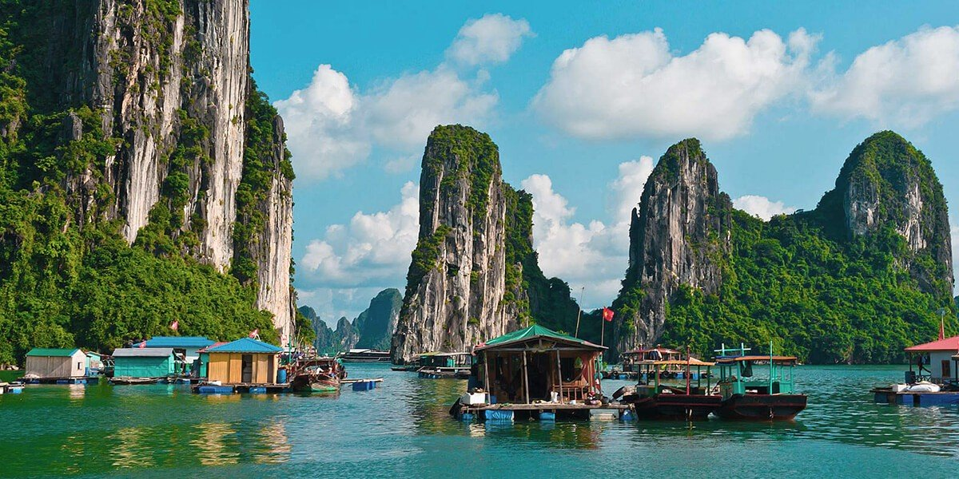
Vietnam

Slide 2
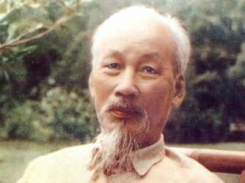
French Rule in Vietnam
French Indochina
  Vietnam
  Laos
  Cambodia
The Indochinese Communist Party had existed since the 1930’s
Ho Chi Minh fled to the U.S.S.R. and later to China
After the Japanese took control of Vietnam Ho Chi Minh returned and formed the Vietminh
When the Japanese left Vietnam in August 1945, Ho Chi Minh declared Vietnam independent.

Slide 3

Ugh. The French.
France is like that horrible boyfriend/girlfriend that just doesn’t know when it’s over.
The French kept driving past Vietnams house and showing up at their job.
The French moved back into Vietnam by the end of 1945.
Meanwhile the U.S. was still committed to containment.
In 1949 China became communist under Mao Zedong
In 1950 North Korea invaded South Korea

Slide 4
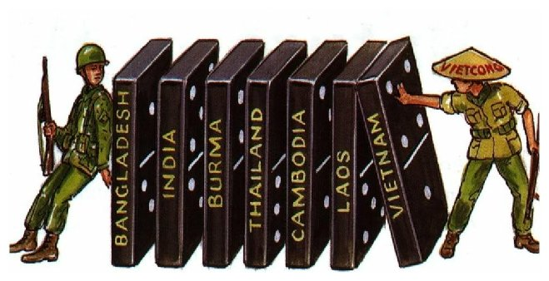
The Domino Theory
Basically…
If one country becomes communist, the next one does as well and eventually the entire region falls to communism threatening free trade and human rights.
So…The U.S. gets involved in this very unhealthy relationship. So if France is the creepy ex driving by the house, the U.S. is his redneck friend on the football team telling him Vietnam is totally going to pay for the way France is getting treated.
The U.S. gives France 15,000,000 dollars in economic aid, totally ignoring the fact that the U.S. had ALREADY given Vietnam 1,000,000,000 dollars to get rid of the Japanese. Which they did.

Slide 5
French Failure
As always, the French failed.
France was unable to control the fate of Vietnam.
French arrogance, and the Vietnamese desire to be independent eventually lead to the French being defeated at Dien Bien Phu in May of 1954.
From May through July of 1954 the countries of France, Great Britain, the Soviet Union, the United States, China, Laos, and Cambodia met in Geneva Switzerland. Also present was the Vietminh, and the Nationalist government of South Vietnam.
This was known as the Geneva Accords.

Slide 6
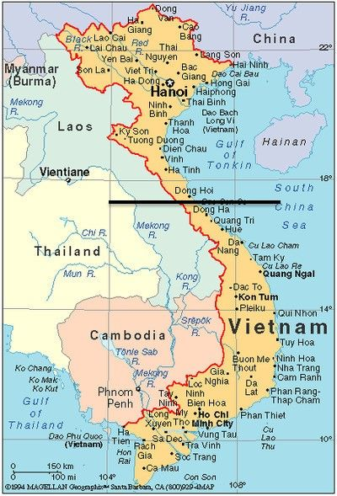
The Geneva Accords
Vietnam was split at the 17th parallel
The communists would control North Vietnam from Hanoi (the capital) and the anti-communists controlled South Vietnam from Saigon (also the capital).
The idea was to call for an election in 1956.

Slide 7
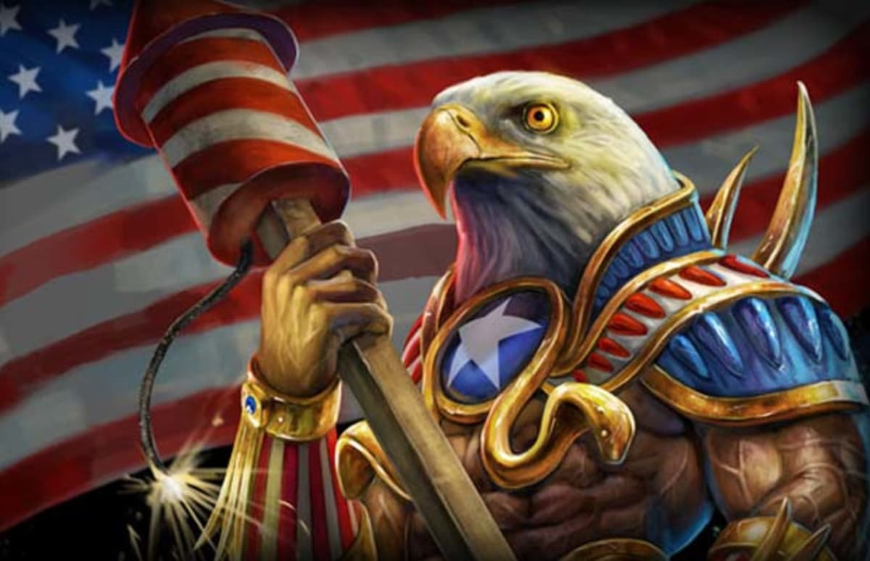
The United States Steps In
The U.S. begins to take a more active interest in Vietnam. (Hey France, if you aren’t interested anymore…you know…maybe we could start dating Vietnam.
France tried to warn us that Vietnam was sort of un-rulable. We did not believe them.
While Ho Chi Minh was redistributing the colonial plantations and land in the North of the Country, the Southern President Ngo Dinh Diem was getting jealous.
Realizing that Ho Chi Minh was A LOT more popular than he was, Diem cancelled the elections of 1956. At least in the South.

Slide 8
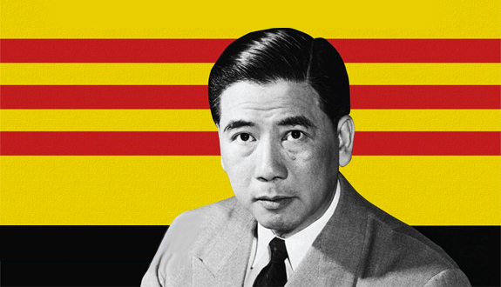
Meanwhile…
In the South a communist group called the Vietcong had begun to openly resist the southern government. This was in 1957.
The Vietcong began to assassinate government leaders. A lot of them. Actually it was in the thousands.
Eventually they would be called the NLF (National Liberation Front).
Ho Chi Minh began supplying arms to the Vietcong (the U.S. continued to call the NLF the Vietcong) along a series of trails called the Ho Chi Minh Trail.
Eisenhower allowed the fate of South Viet Nam to rest on the back of President Diem. Basically sink or swim was how he described it.

Slide 9
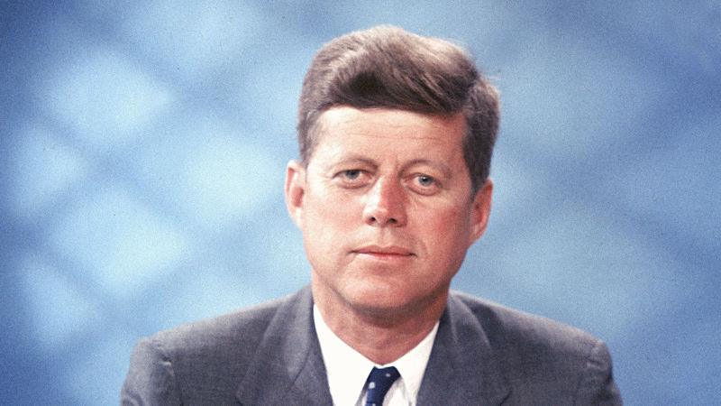
Kennedy and Vietnam
In 1961 Kennedy enters the Whitehouse. He is criticized for being “soft” on communism so he starts funneling more money to President Diem.
The U.S. also sent 16,000 military “advisers” to South Vietnam by 1963.
Diem continued to lose popularity.
The Diem regime began the strategic hamlet program. He just moved entire villages away from their ancestral homelands (which is a big deal in Vietnamese culture) to “safe areas”.

Slide 10
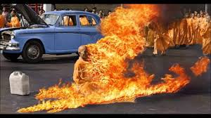
The End of Diem
Diem saw Buddhism as a threat. He intensified attacks on Buddhists.
Diem imprisoned and executed hundreds of Buddhist Clerics.
Diem destroyed Buddhist Temples.
Basically his strategy was to win the love of the people he would destroy everything they loved.
To Protest this the Buddhist Monks and Nuns began to protest the government by burning themselves alive.
The U.S. was horrified by this and we asked Diem to knock that crap off.
Diem refused so the U.S. let him get assassinated on November 1, 1963.
Two weeks later Kennedy was assassinated (also but for different reasons) and Lyndon Baines Johnson became President. Now Vietnam was his problem and it was about to get real.

