Slide 1
Hooray! WWI
The worlds fasted teaching of WWI

Slide 2
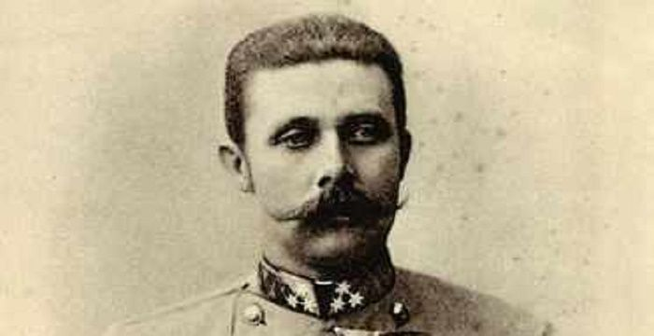
It’s Sunday. I’ve been fighting soccer moms and then I went to the beach. I have no one to tell me to do this. And yet…because I care…Here is WWI.
Here is how the war started…
Nationalism
Imperialism
Militarism
Alliance System

Slide 3
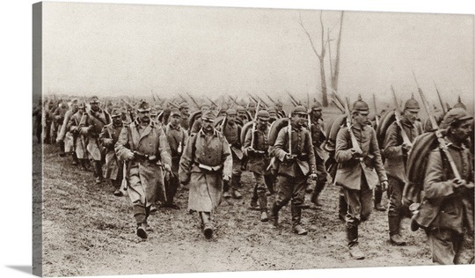
Then!
There was an assassination.
Archduke Franz Ferdinand was killed by a Serbian Nationalist. This will now be demonstrated by Nick and Erica. If they are still awake. Otherwise…
Everyone blames everyone else.
Germany marches through Belgium
People dig trenches
The U.S. doesn’t choose a side. It chooses every side.

Slide 4
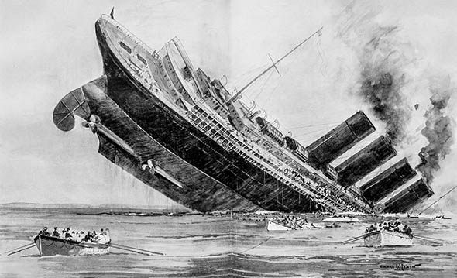
Also don’t forget
The Lusitania. It sinks. This will be acted out by and Raquel and Lucas.
Then the Arabic. It sinks. This will be acted out by Arturo and Abbie
Then the Sussex. It sinks. This will be acted out by Jack and Jack.
This leads to the Sussex Pledge. I imagine this will be on the test.
The U.S. and Germany have an agreement but there are terms involved. The U.S. has to persuade Britain to lift the blockade on Germany. If not, Germany will sink everything. Everywhere. (that’s an exaggeration, but the spirit remains the same.)

Slide 5
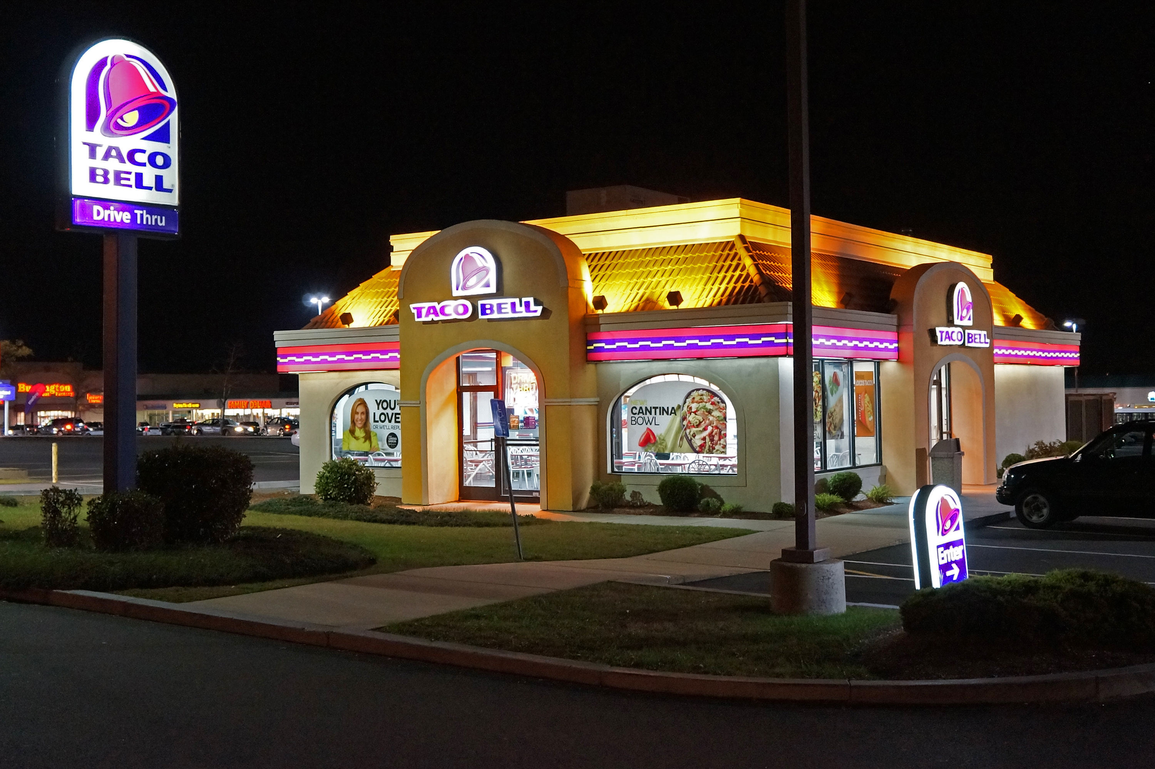
Wilson is elected in 1916
He was elected with the slogan “He kept us out of war”.
On January 31 1917 the German Kaiser tweeted that “U-boats will sink all ships in British waters neutral or not, and some skinny nerd of an American President will not stop us!”#Lusitania
Wilson tweeted back “Bring es Hündin!”
Then a DM meant for Mexico was intercepted by the British. Here it is word for word:
“Hey Mexico. Remember Texas? California? How would you like to build a chain of Taco Bells from Tijuana to Louisiana? Join Germany in the war and the entire Southwest U.S. will be returned to you. And also, Wilson sucks. Love Germany.”

Slide 6
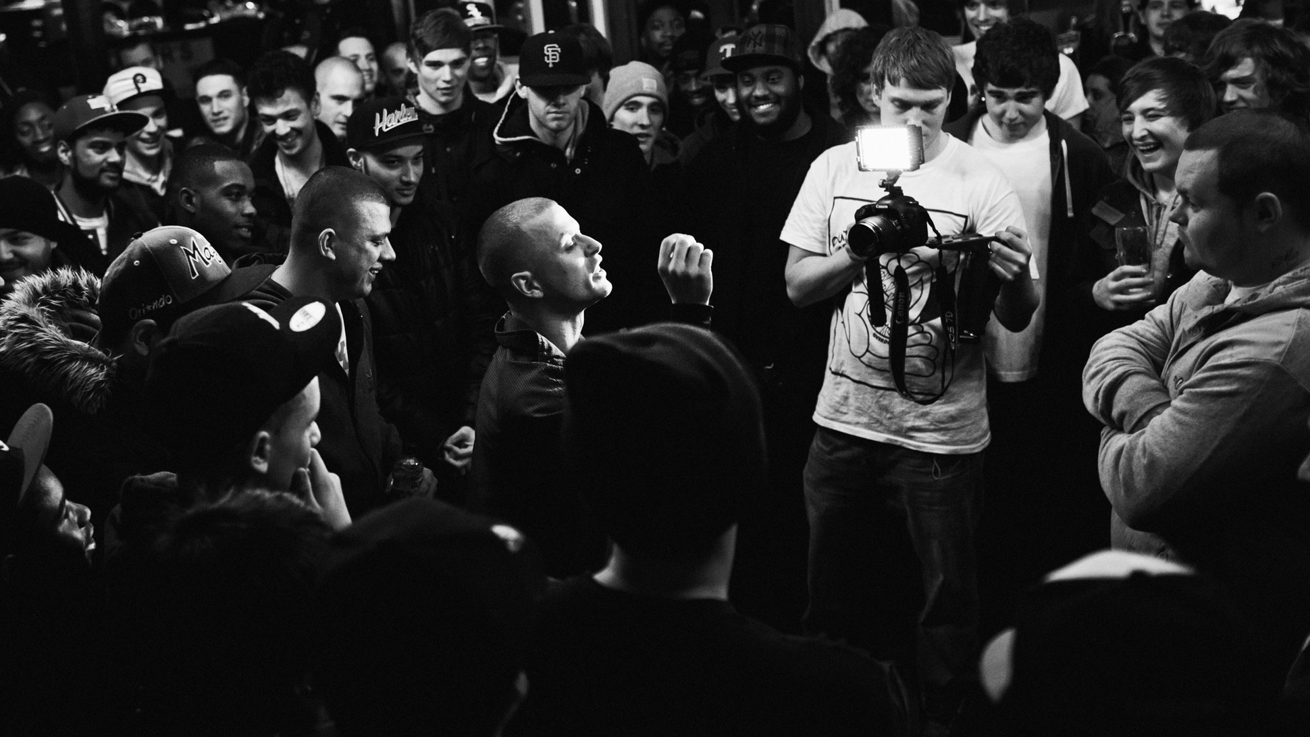
The United States Declares War!
Wilson responds to the Zimmerman tweet with a tweet of his own “Hey Kaiser! No you didn’t!”
Woodrow Wilson then challenged Kaiser Wilhelm to an epic rap battle and breakdance fight.
Germany sent out an official tweet “Bring it!”
The U.S. responded “It’s been brought and paid for!” That then reminded Wilson that Germany owed the U.S. a lot of money and maybe it would be easier to just go to where the war was being fought and just shoot Germany in the face. So the U.S. entered the war.

Slide 7
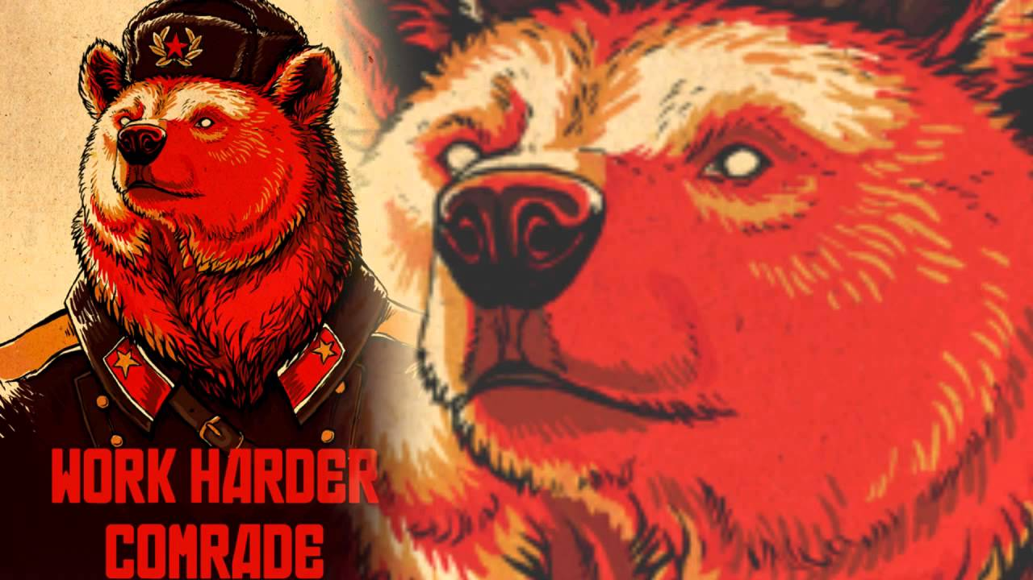
Oh. Russia
Yeah. Russia. Russia decides to be communist. So the Bolsheviks revolt under the leadership of Vladimir Lenin.
The Tsar and his family are captured and taken to the forest and killed.
But that was the last shady thing Russia ever did. And they didn’t want to be called Russia anymore. They wanted to be called Flynn. When that didn’t catch on they went with the United Soviet Socialist Republic. For some reason people liked that better.
In 1917 the U.S.S.R. signed a separate peace with Germany in the treaty of Brest-Litovsk. This allowed more Germans to come to the western front in France.

Slide 8
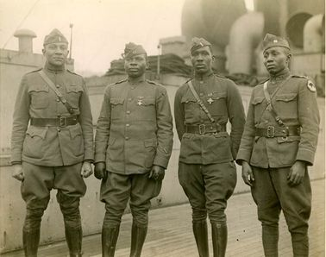
Ok…it’s on.
America mobilizes.
Congress passes the Selective Service Act in 1917.
24 million men sign up, 3 million are drafted and 2 million make it all the way to Europe.
The U.S. encouraged men from all races to sign up. However the U.S. military was still segregated. Many black soldiers found France to be more open and proactive in race relations, and many of them stayed in France.
American Indians were also asked to fight, even though they were not technically citizens. Women also served in various roles and won the respect of Wilson not only in the military, but also in the role they played in the U.S.

Slide 9
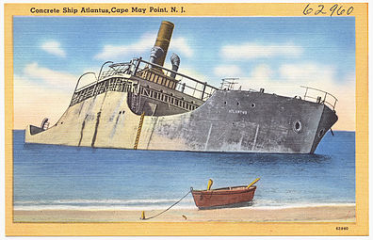
Mass Production
Ships were produced. En masse.
As were many things. Prefabrication became a thing.
Women worked in factories.
Shipyard workers were generally deferred from the draft.

Slide 10
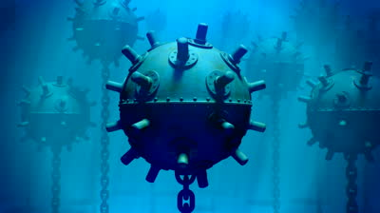
The Navy and the Army
The Convoy System
Wolf Packs
230 miles of mines.
The American Expeditionary Forces
General John J. Pershing

Slide 11
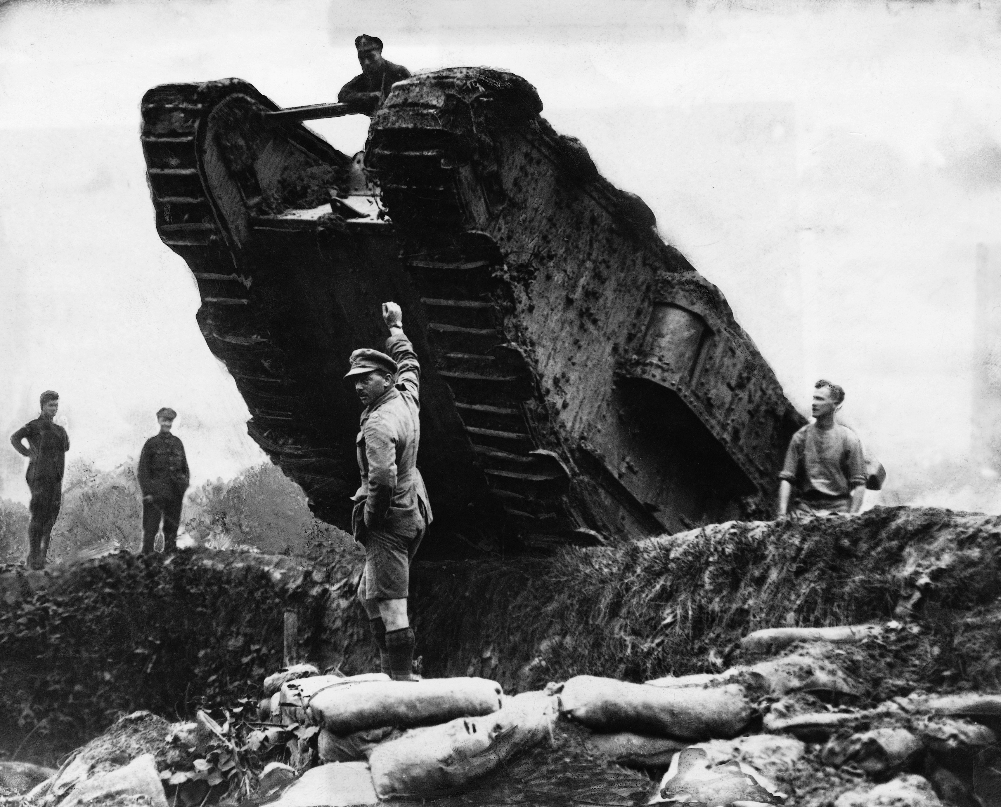
Technology
Machine Guns
Airships and Airplanes
Poison gas
Hand Grenades
Tanks
Dreadnoughts

Slide 12
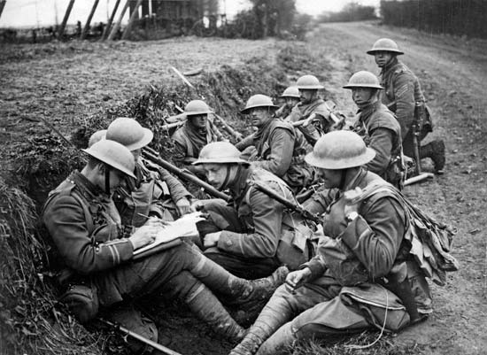
Fighting

Slide 13
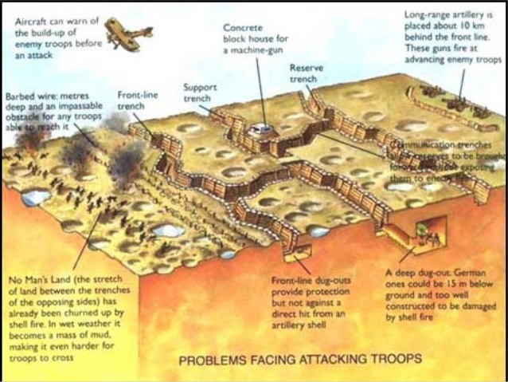
Fighting

Slide 14
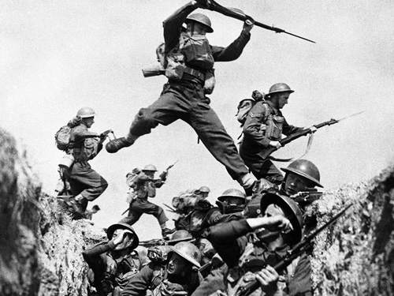
More Fighting

Slide 15
The Collapse of Germany
Germany Collapses.

Slide 16
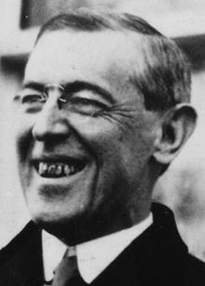
And finally…
Germany surrenders with the understanding that the 14 Points written by Wilson will be adhered to.
They weren’t.
This will lead to problems.

Slide 17
The Final Toll
22 million killed
Half of the 22 million were civilians
20 million were wounded.
10 million become refugees.
And now it’s all over.

Slide 18
Hah! It’s not! You also have to know…
War Industries Board
Bernard M. Baruch
Liberty Loans Bonds
Victory Loan Bonds
Propaganda
Committee on Public Information
George Creel
Alien and Sedition Acts
The Great Migration
Oh and also in 1918 there was a flu epidemic and everyone died. Ok, not everyone. About 500,000. Look around. Out of the 25 or so people in the room all of you would be dead. And also around 499,975 more people. Not me. I’d be fine.

Slide 19
Ok
It is now ok for you to wake up and receive your study guides. Please enjoy them wisely.

