Slide 1
World Population Distribution and Density
Where is everyone?

Slide 2
East Asia
Most people are crowded into China. The population is crowded into urban areas as well as into the river valleys.
This area of large population includes not only Eastern China, but the Korean Peninsula and Japan. The growth of these nations is very different (as will be seen when you have your next mini-project)

Slide 3
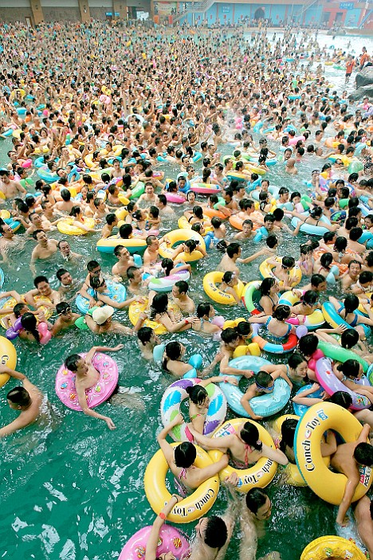
East Asia
Almost one quarter of the world’s population lives here. There are over 1.3 billion people in China.

Slide 4
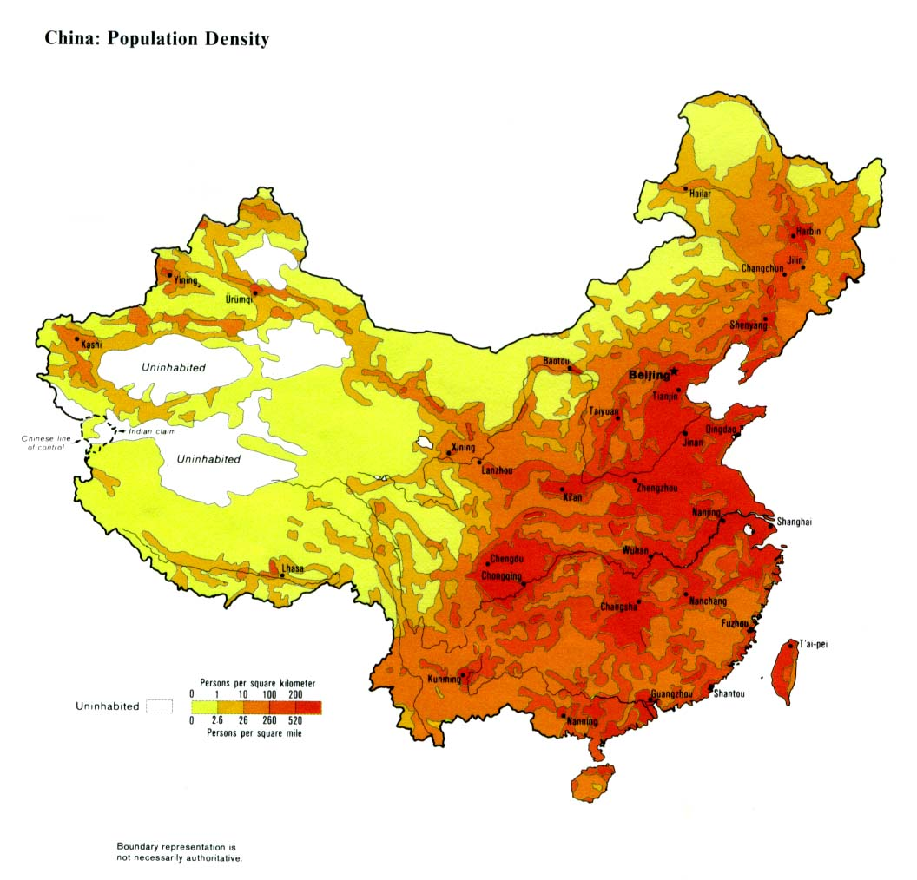
China Population Density

Slide 5
South Asia
This area is second in World Population Density. Similar to East Asia most of the population survives by farming but the pressure on the land is greater.

Slide 6
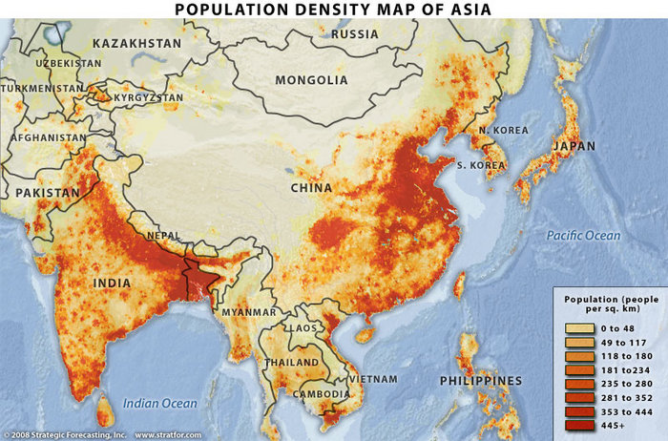
Population Density Asia

Slide 7
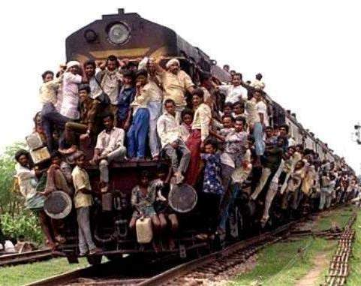
India

Slide 8
Europe
Europe is densely populated. A population cluster of 715 million extends from Ireland to Russia and south to Italy. This is still less than half the population cluster of South Asia.
The Population cluster of Europe reflects natural resources like coal, more than fertile farming regions. This is in contrast to Asia. (you should be able to offer some hypothesis as to why this is.)…Heartland Theory (more later)

Slide 9
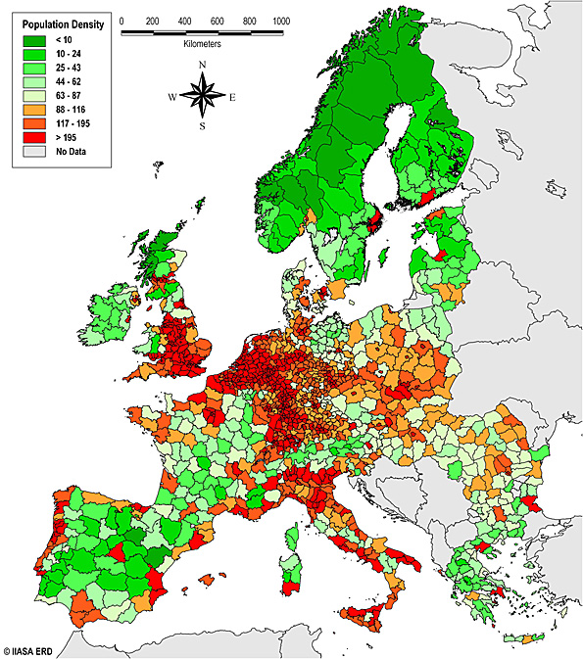
Population Europe

Slide 10
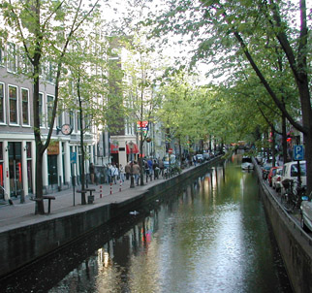
Population Europe

Slide 11
Perspective…
The 3 population clusters just spoken about, East Asia, South Asia, and Europe account for over 4 billion people. The world population is just 6.7 billion people.
The Populations of South America, Africa, and Australia combined barely exceeds that of just India. Go India! (Rapidly catching up with China)

Slide 12
North America
Most of the population of North America is clustered in the Megalopolis of Bosnywash. This includes the urban areas of the Eastern U.S., but could be extended west to include the population centers of the Great Lakes region. This would include the major population centers of Canada as well.

Slide 13
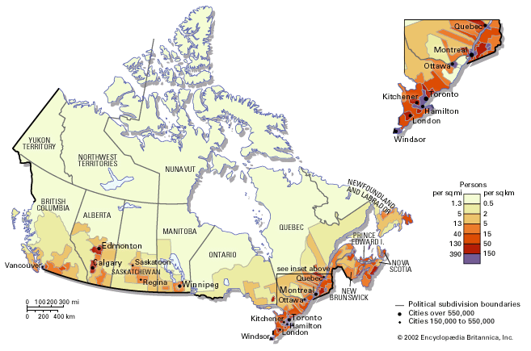
North American Population Density (Canada)

Slide 14
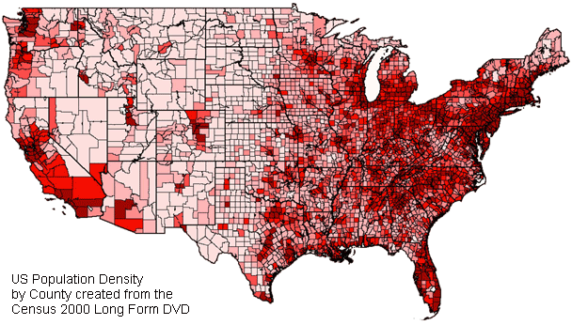
Population Density North America (U.S.)

Slide 15

Population Canada

Slide 16

Population U.S.

