Slide 1
Holy Crap It’s WWII!

Slide 2
Some stuff you need to know:
The Holocaust happened. If anyone ever tells you otherwise it is OK to punch them.
We did not fight this war alone. We had help. Lots of it.
This war probably could have been avoided if the fourteen points of WWI had been adhered to.
The U.S. tried to remain neutral. That didn’t work out so well. Oh, there was a group called America First. They are generally on the wrong side of history. Basically they thought that Hitler was cool as long as he left America alone. They sort of liked Hitler. It’s NOT ok to be sort of a Nazi. Also, I’m pretty sure I’ve heard that term before…

Slide 3
Failure of the Treaty of Versailles
Yeah. Treaty of Versailles failed for various reasons, but mostly because the U.S. decided not to join the League of Nations.
Lots of dictators fascist and otherwise began to gain power after WWI.
For example…Benito Mussolini
Joseph Stalin
Francisco Franco
Adolph Hitler
There was also a plot to overthrow the U.S. government with a coup and install a fascist government. It failed. It was led by Prescott Bush. He happens to be the Grandfather of George W. Bush and the Father of George H.W. Bush. It’s not in the book but it happened. Also Texas (where the Bushes are from, control EVERYTHING in U.S. History texts. So, yeah.)

Slide 4
So…
Adolph Hitler was an asshole.
A lot of people will try to convince you otherwise.
They will tell you he was a great leader but kind of nuts.
They will say he was a military genius.
He was not a great leader and not a genius in any way. He was a pretty good speaker but so is Logan Paul in his way.
At any rate he is appointed Chancellor of Germany in 1933. He is pretty quick to make his opinions on people that are Jewish, Homosexual, Jehovah’s Witnesses, Gypsies, Disabled, Mexican etc. pretty well known. It’s what terrible people do to get other terrible people (which is most people unfortunately) to agree with them. But that could never happen here. Ever. Never. No American would ever put up with that.

Slide 5
Militarists Gain Control in Japan
Japan. Tom Cruise tried to save them but ultimately failed.
So…
Japan tries (and succeeds) to create an empire.
Hideki Tojo

Slide 6
Civil War Breaks Out in Spain
Francisco Franco
George Orwell
Ernest Hemingway
The Clash
Pan’s Labyrinth
All of these are somehow involved in the Spanish Civil War.
Spanish Bombs

Slide 7
And then…
Germany starts taking things. (Irredentism)
The Rhineland
Italy begins taking things.
Ethiopia

Slide 8
Austria and Czechoslovakia
Most people in Austria were Germans and they favored reunification with Germany
Czechoslovakia was another issue.
The Sudetenland
Friedrich Ratzel
Neville Chamberlin
Winston Churchill
Appeasement

Slide 9
Germany and Poland
Well…
Germany wants Poland. As far as anyone knows so does the U.S.S.R.
Hitler starts talking crap about how Poland is mistreating Germans in Poland.
No one thinks he will invade because the U.S.S.R. is too powerful.
However…in 1939 the U.S.S.R. signs a peace treaty with Hitler (Nonaggression pact)
On September 1, 1939 Hitler invades Poland and its on.
Also. Blitzkrieg.

Slide 10
The Phony War
France just sort of waited for an invasion along the Maginot line.
Hitler took the Baltic States (Estonia, Latvia and Lithuania)
Stalin took Finland (not easily nor completely though)
Actually this is a little annoying. Your book throws out Finland like it just sort of fell. Not so. Check out the Winter War. Finland is pretty badass.
Hitler then moves into Denmark and Norway (where the Nazis do unspeakable things)
Then they invade France. France does surrender. Like immediately. It was almost as if they were annoyed at being French and couldn’t wait to try out being on the winning side for once.
Dunkirk
The Battle of Britain.

Slide 11
Now!
Go watch Darkest Hour.
Then watch Dunkirk.
Ok.

Slide 12
Vocabulary
Joseph Stalin
Totalitarian
Benito Mussolini
Fascism
Adolph Hitler
Nazism
Hideki Tojo
Neville Chamberlain
Winston Churchill
Appeasment
Nonaggression Pact
Blitzkrieg

Slide 13
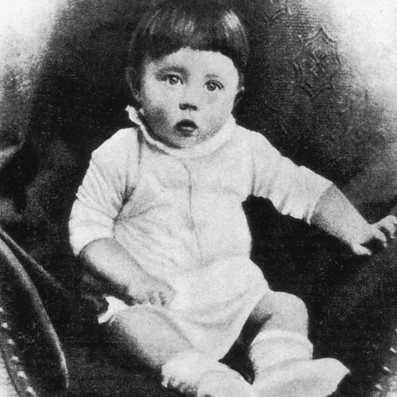

Slide 14
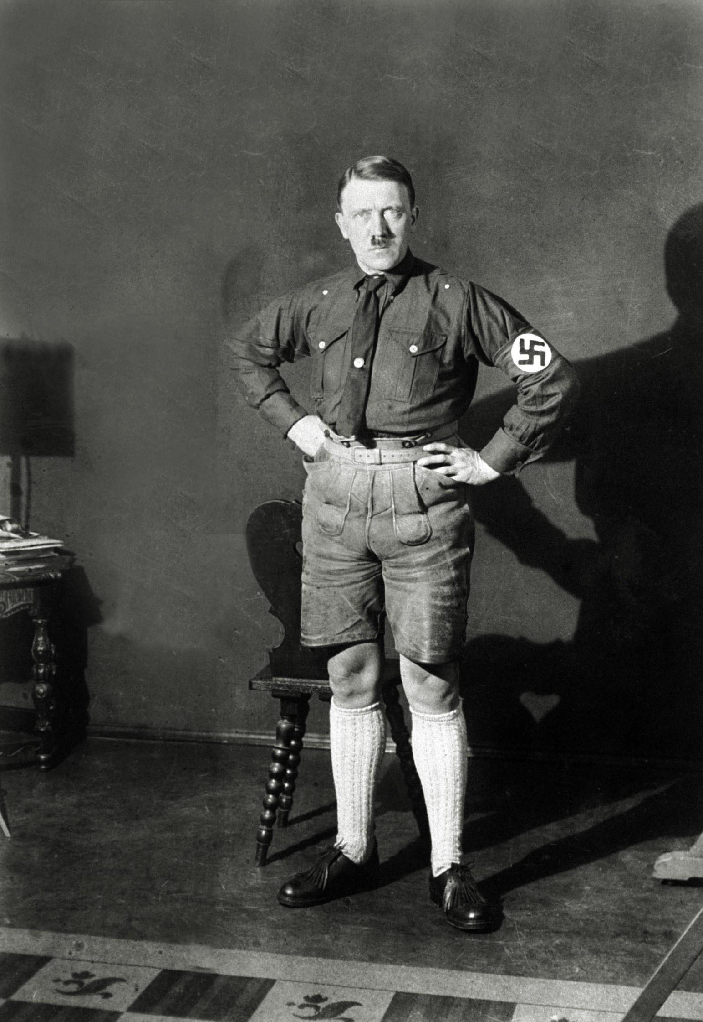

Slide 15
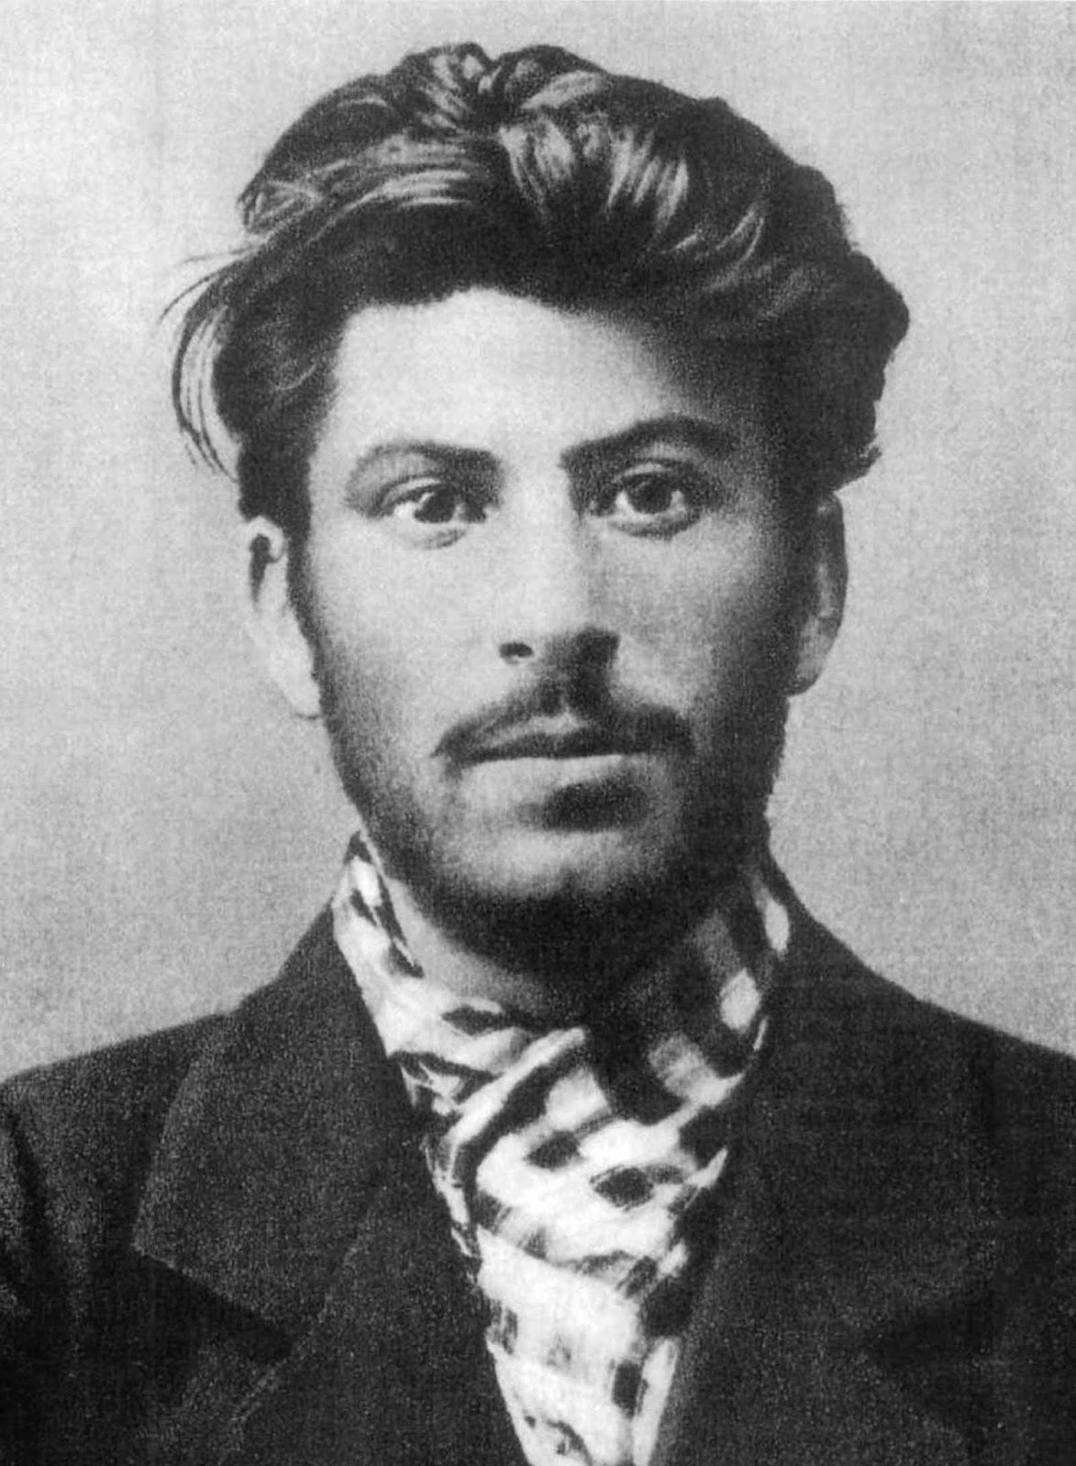

Slide 16
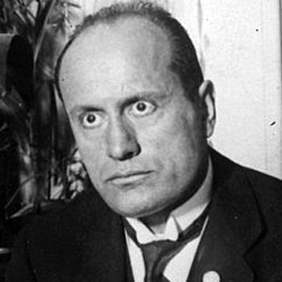

Slide 17
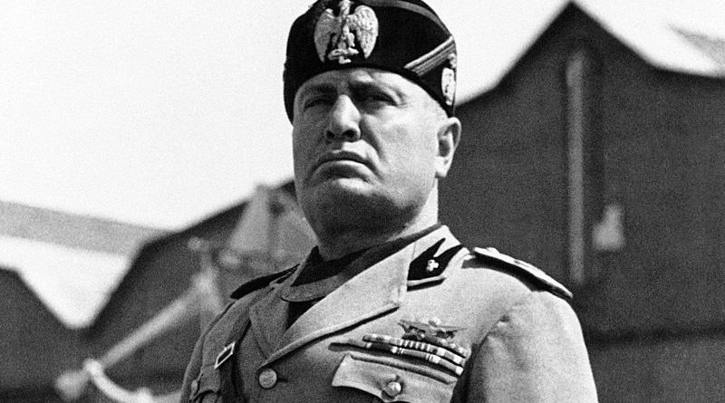

Slide 18
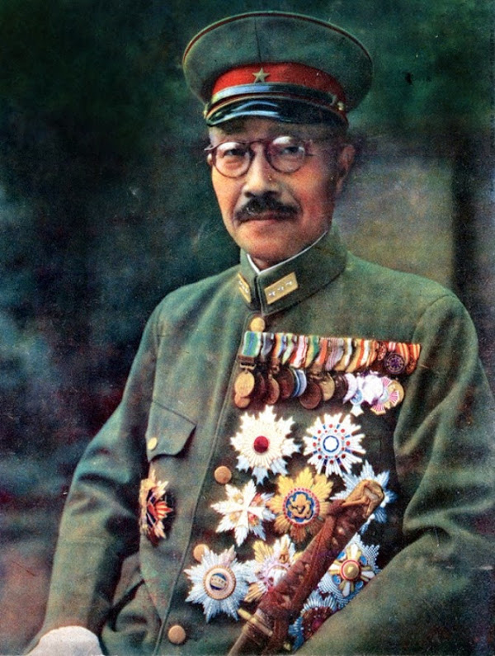

Slide 19
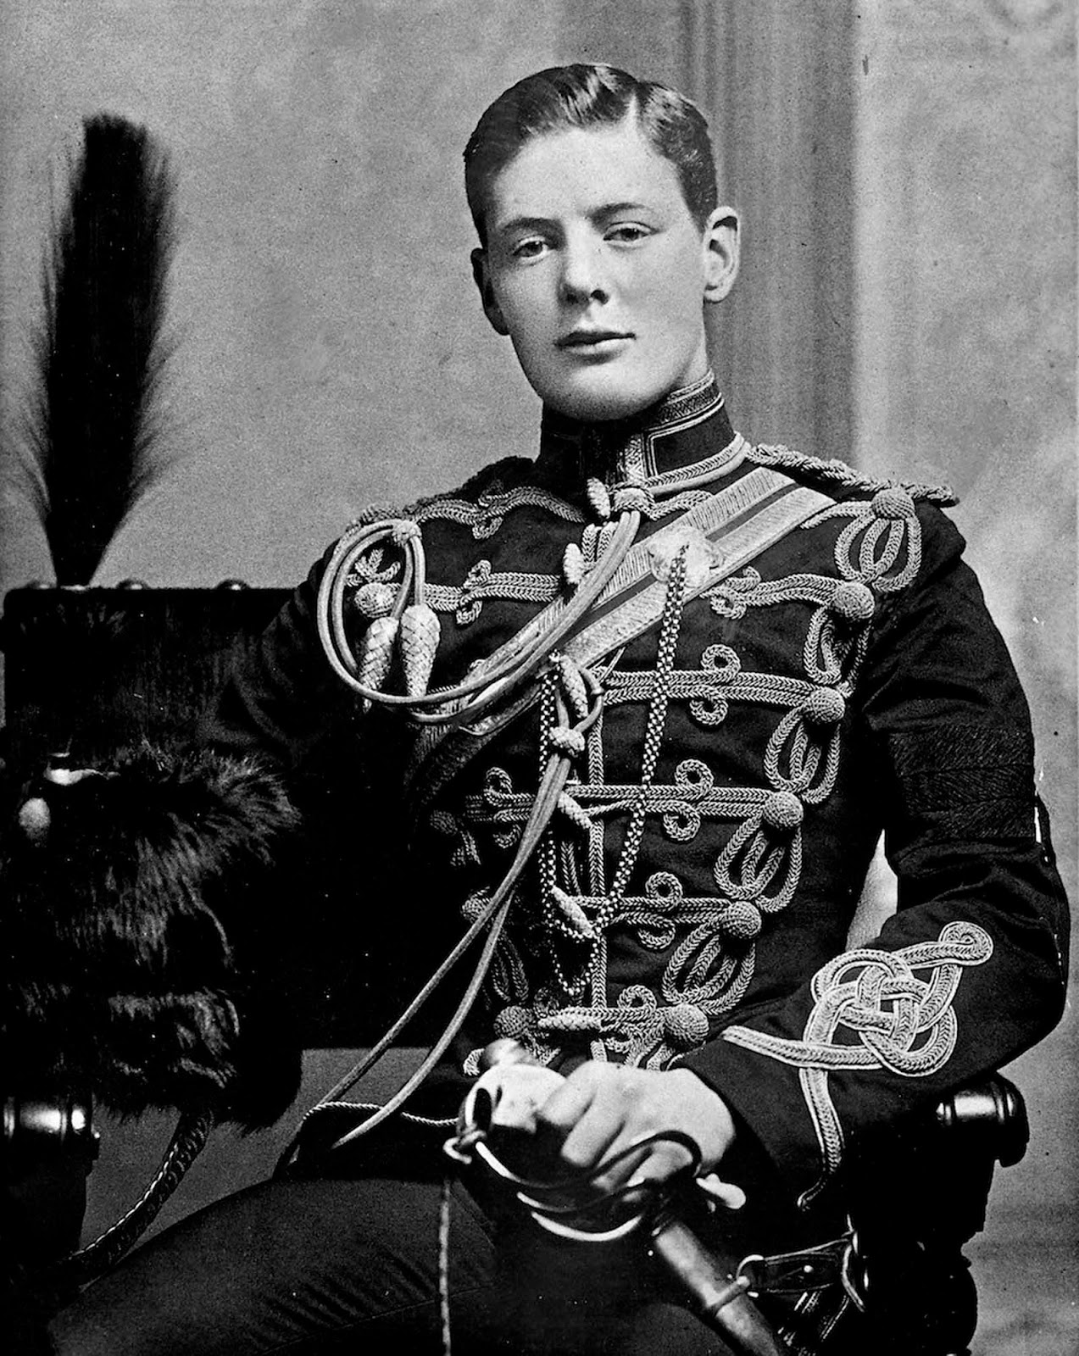

Slide 20
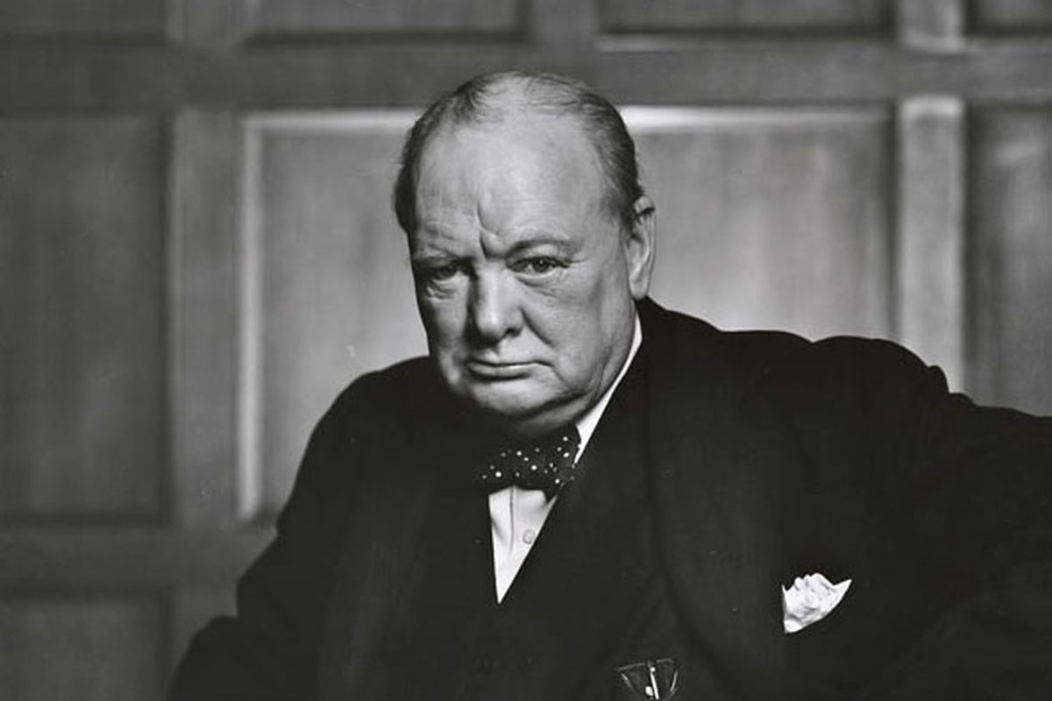

Slide 21
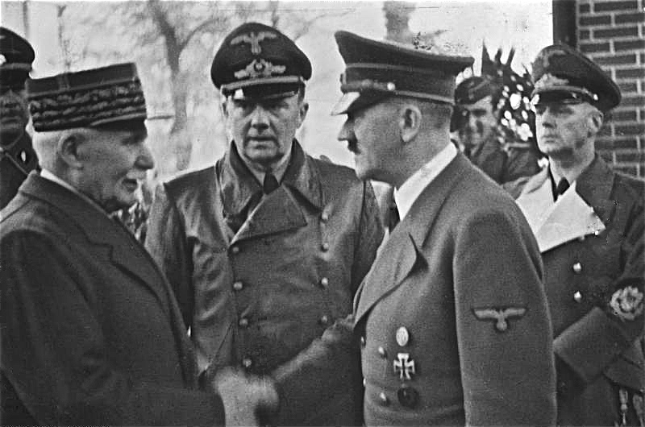

Slide 22
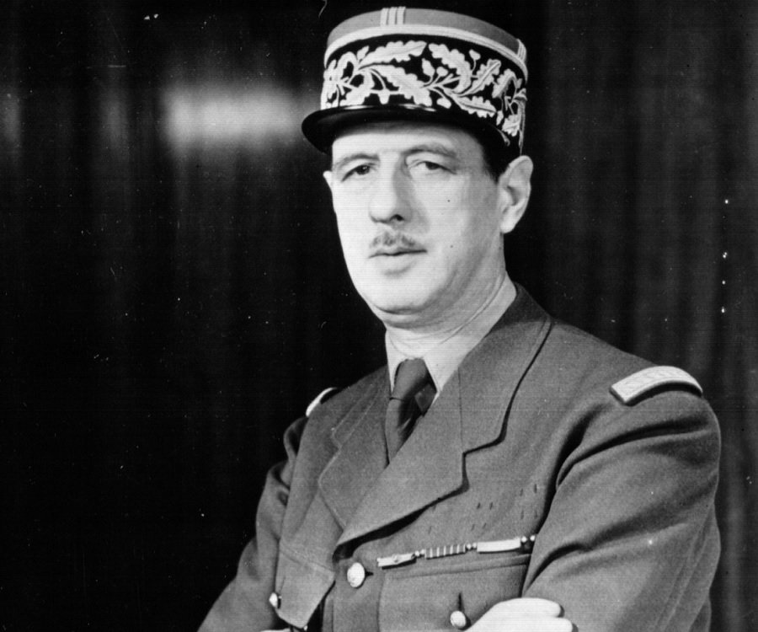

Slide 23
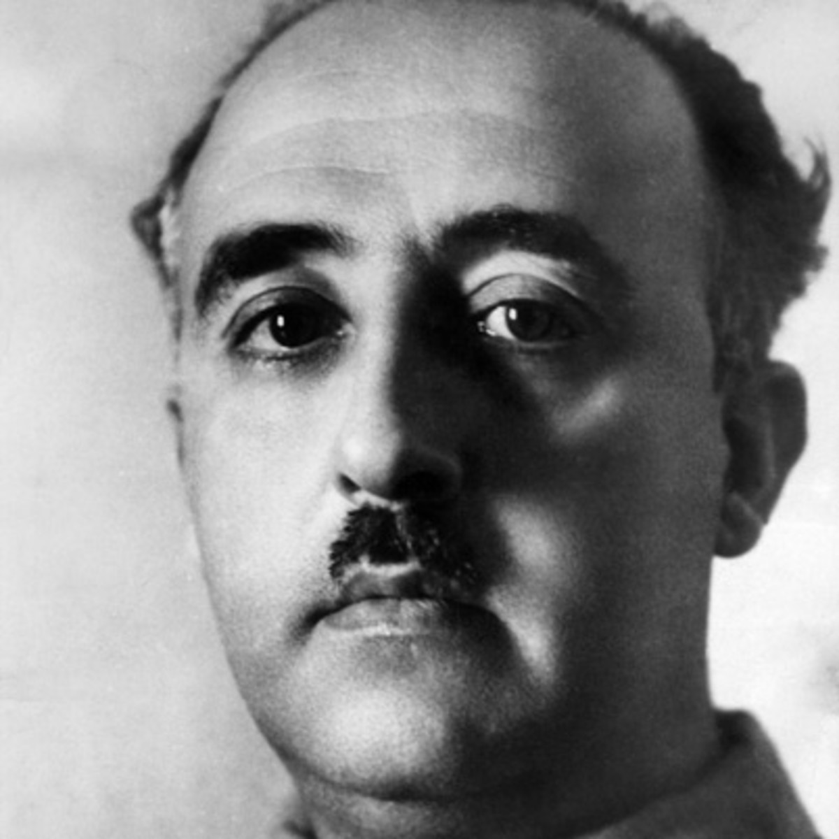

Slide 24
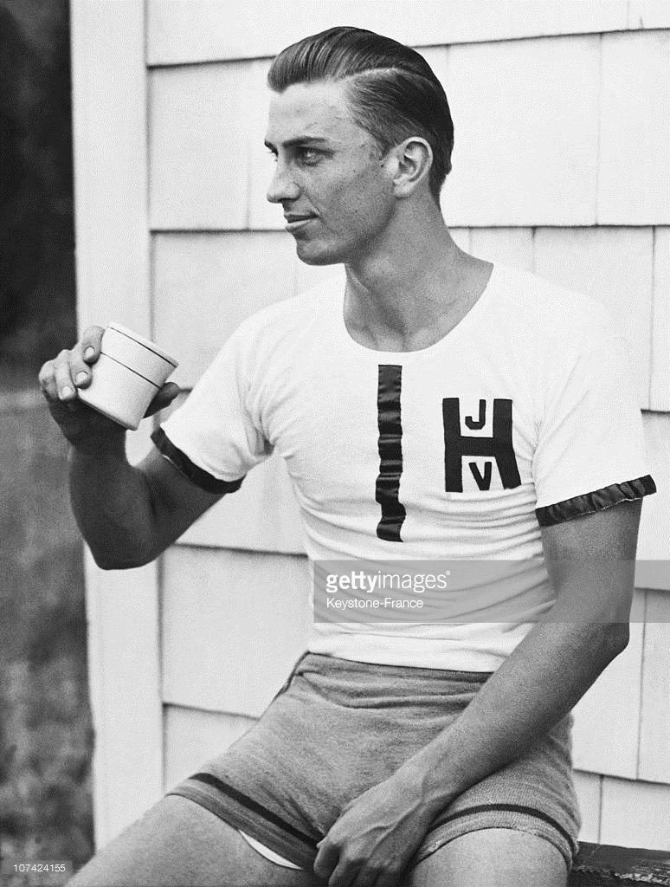

Slide 25
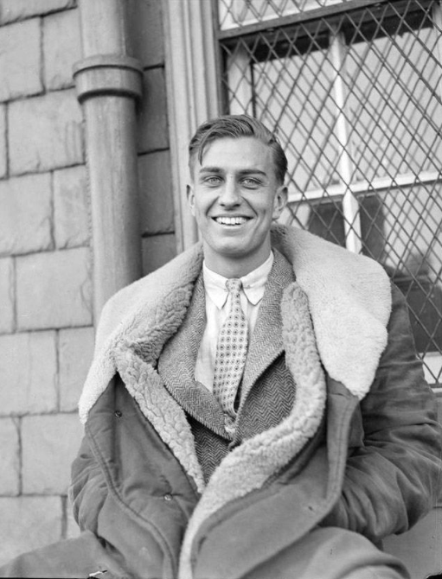

Slide 26
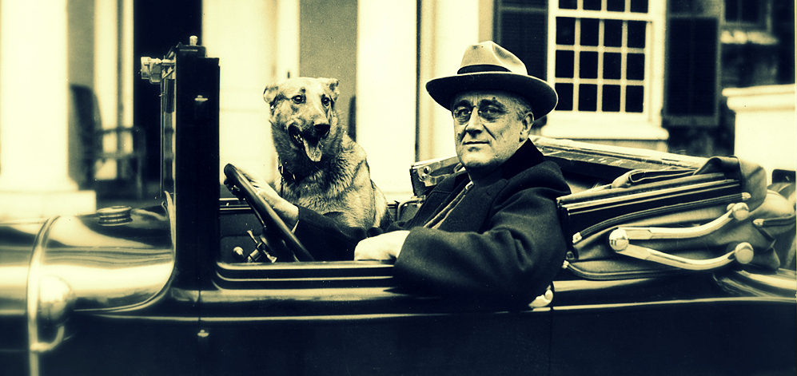

Slide 27
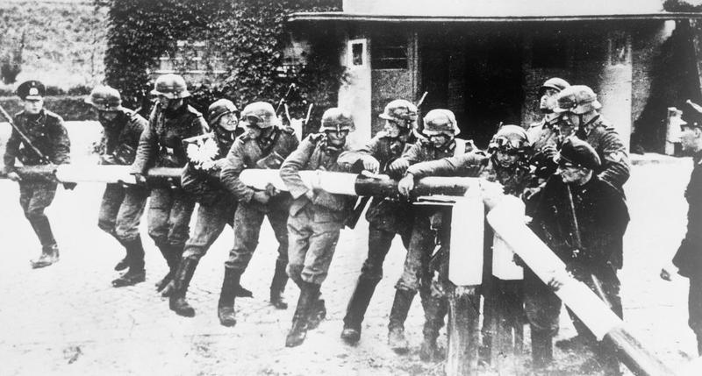

Slide 28
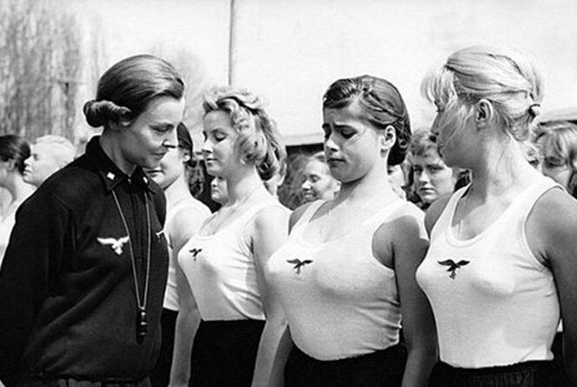

Slide 29
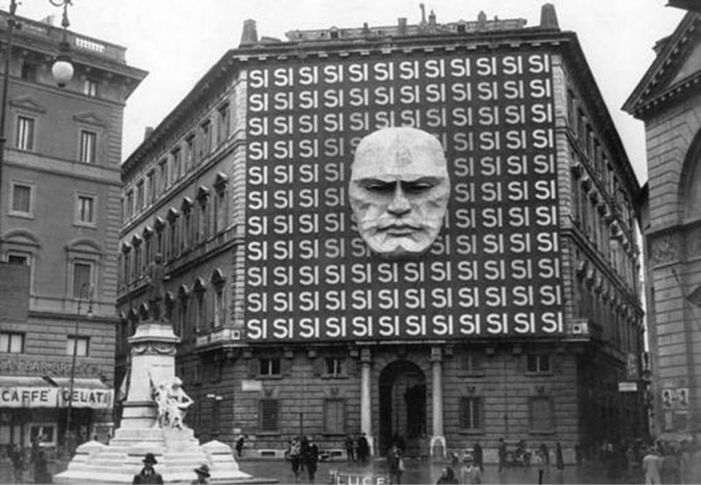

Slide 30
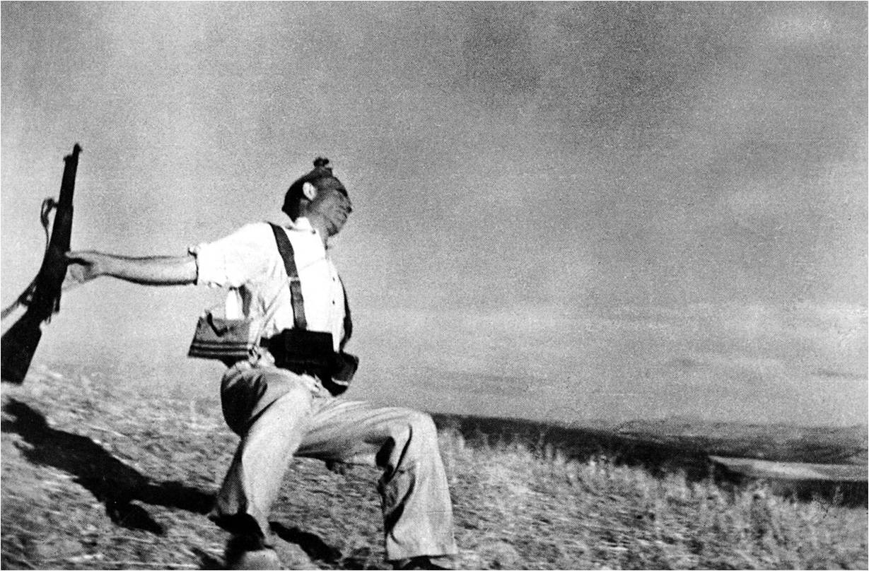

Slide 31
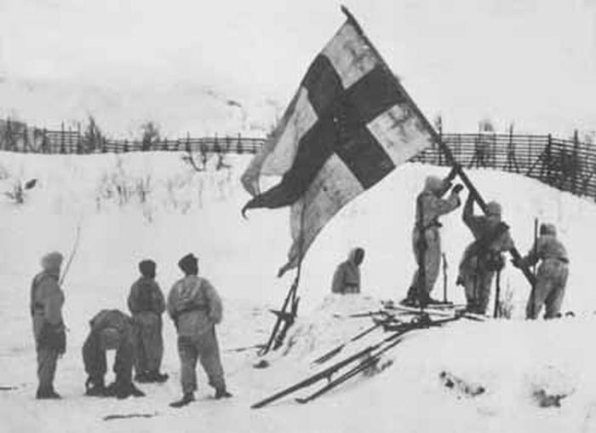

Slide 32
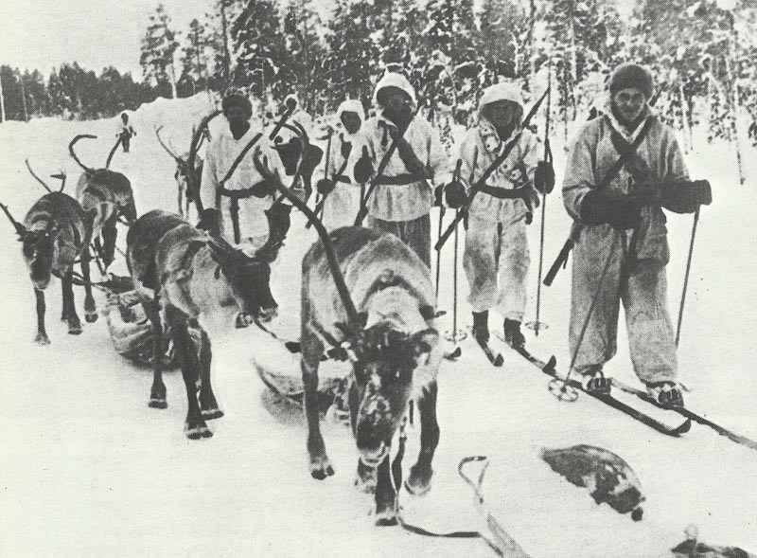

Slide 33
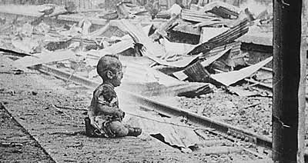

Slide 34
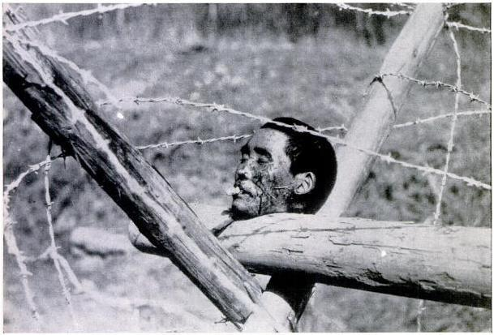

Slide 35
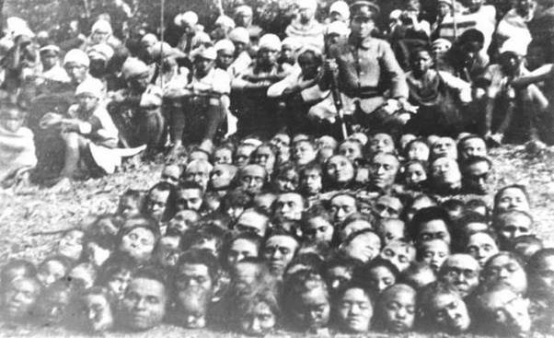

Slide 36
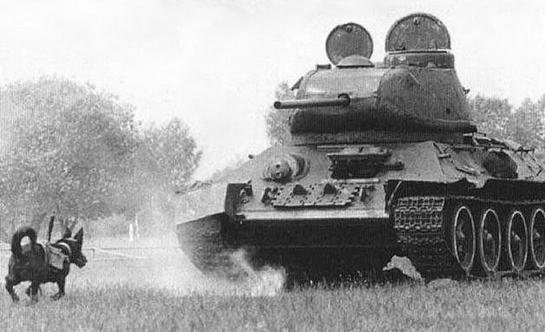

Slide 37
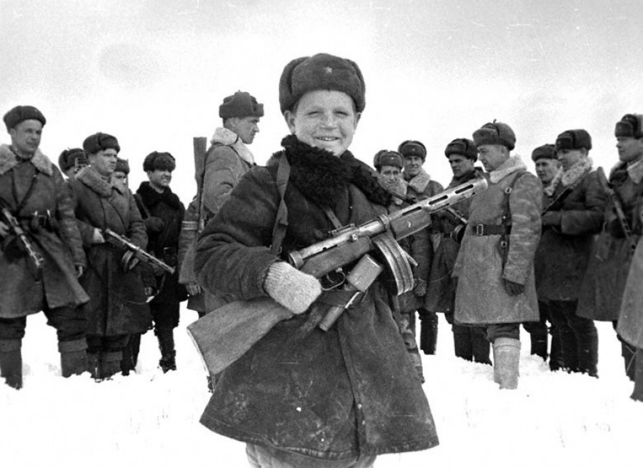

Slide 38
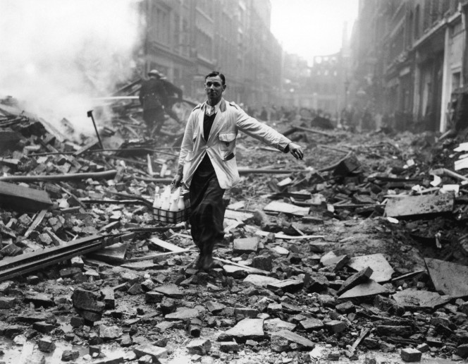

Slide 39
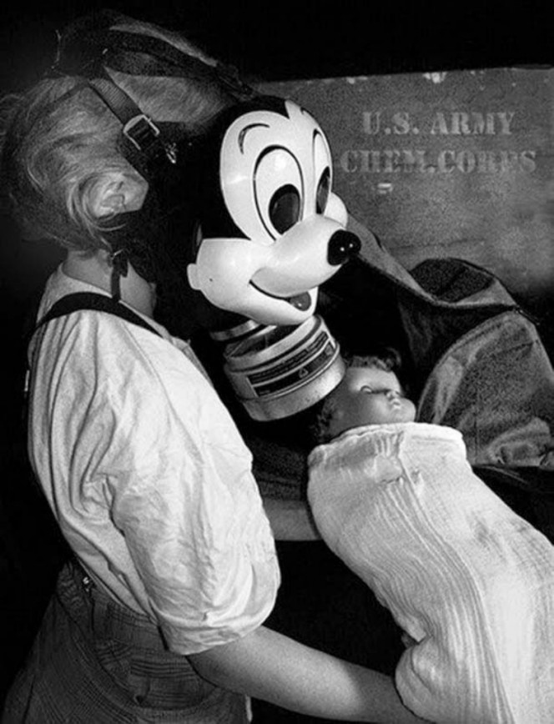

Slide 40
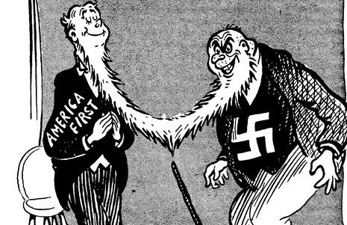

Slide 41
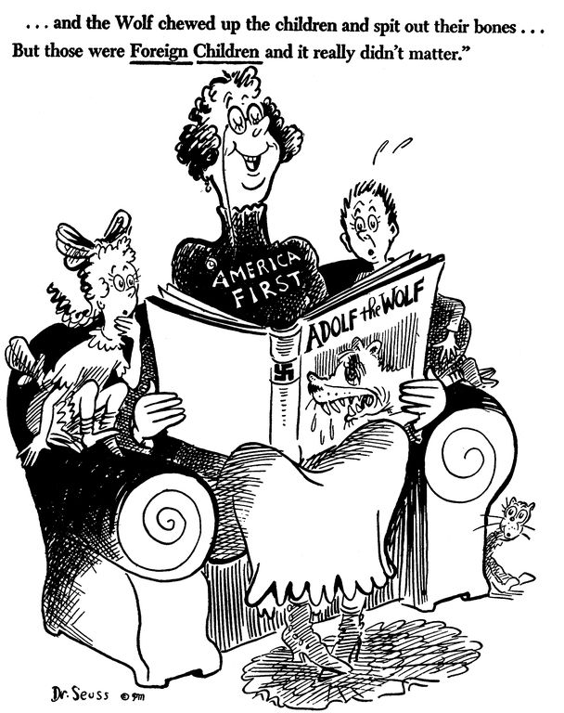

Slide 42
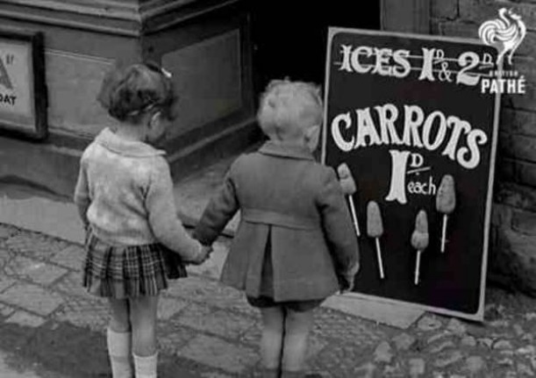

Slide 43
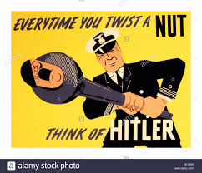

Slide 44
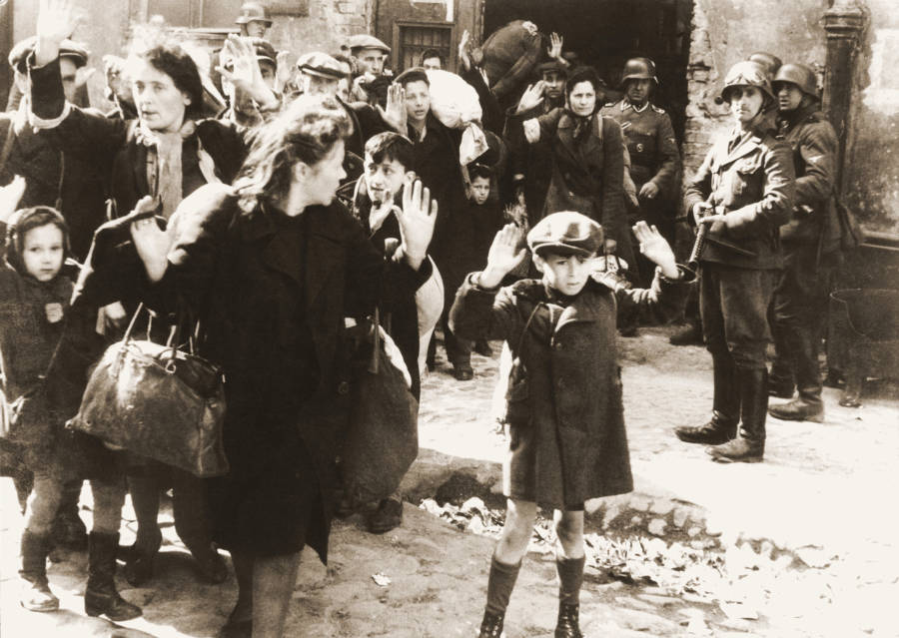

Slide 45
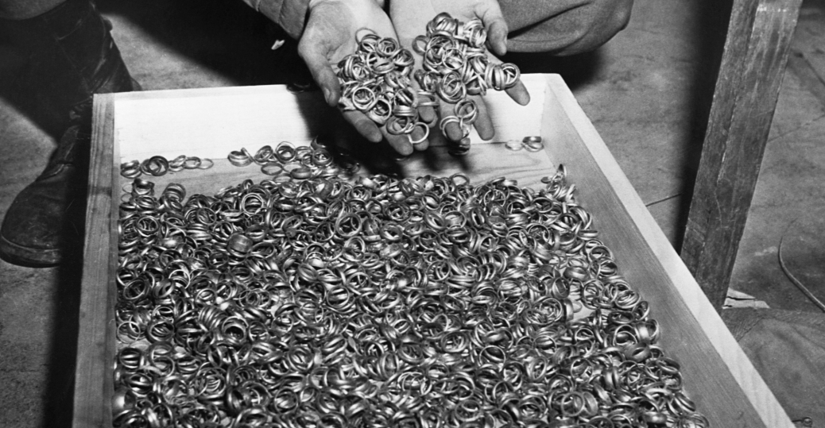

Slide 46
