Slide 1
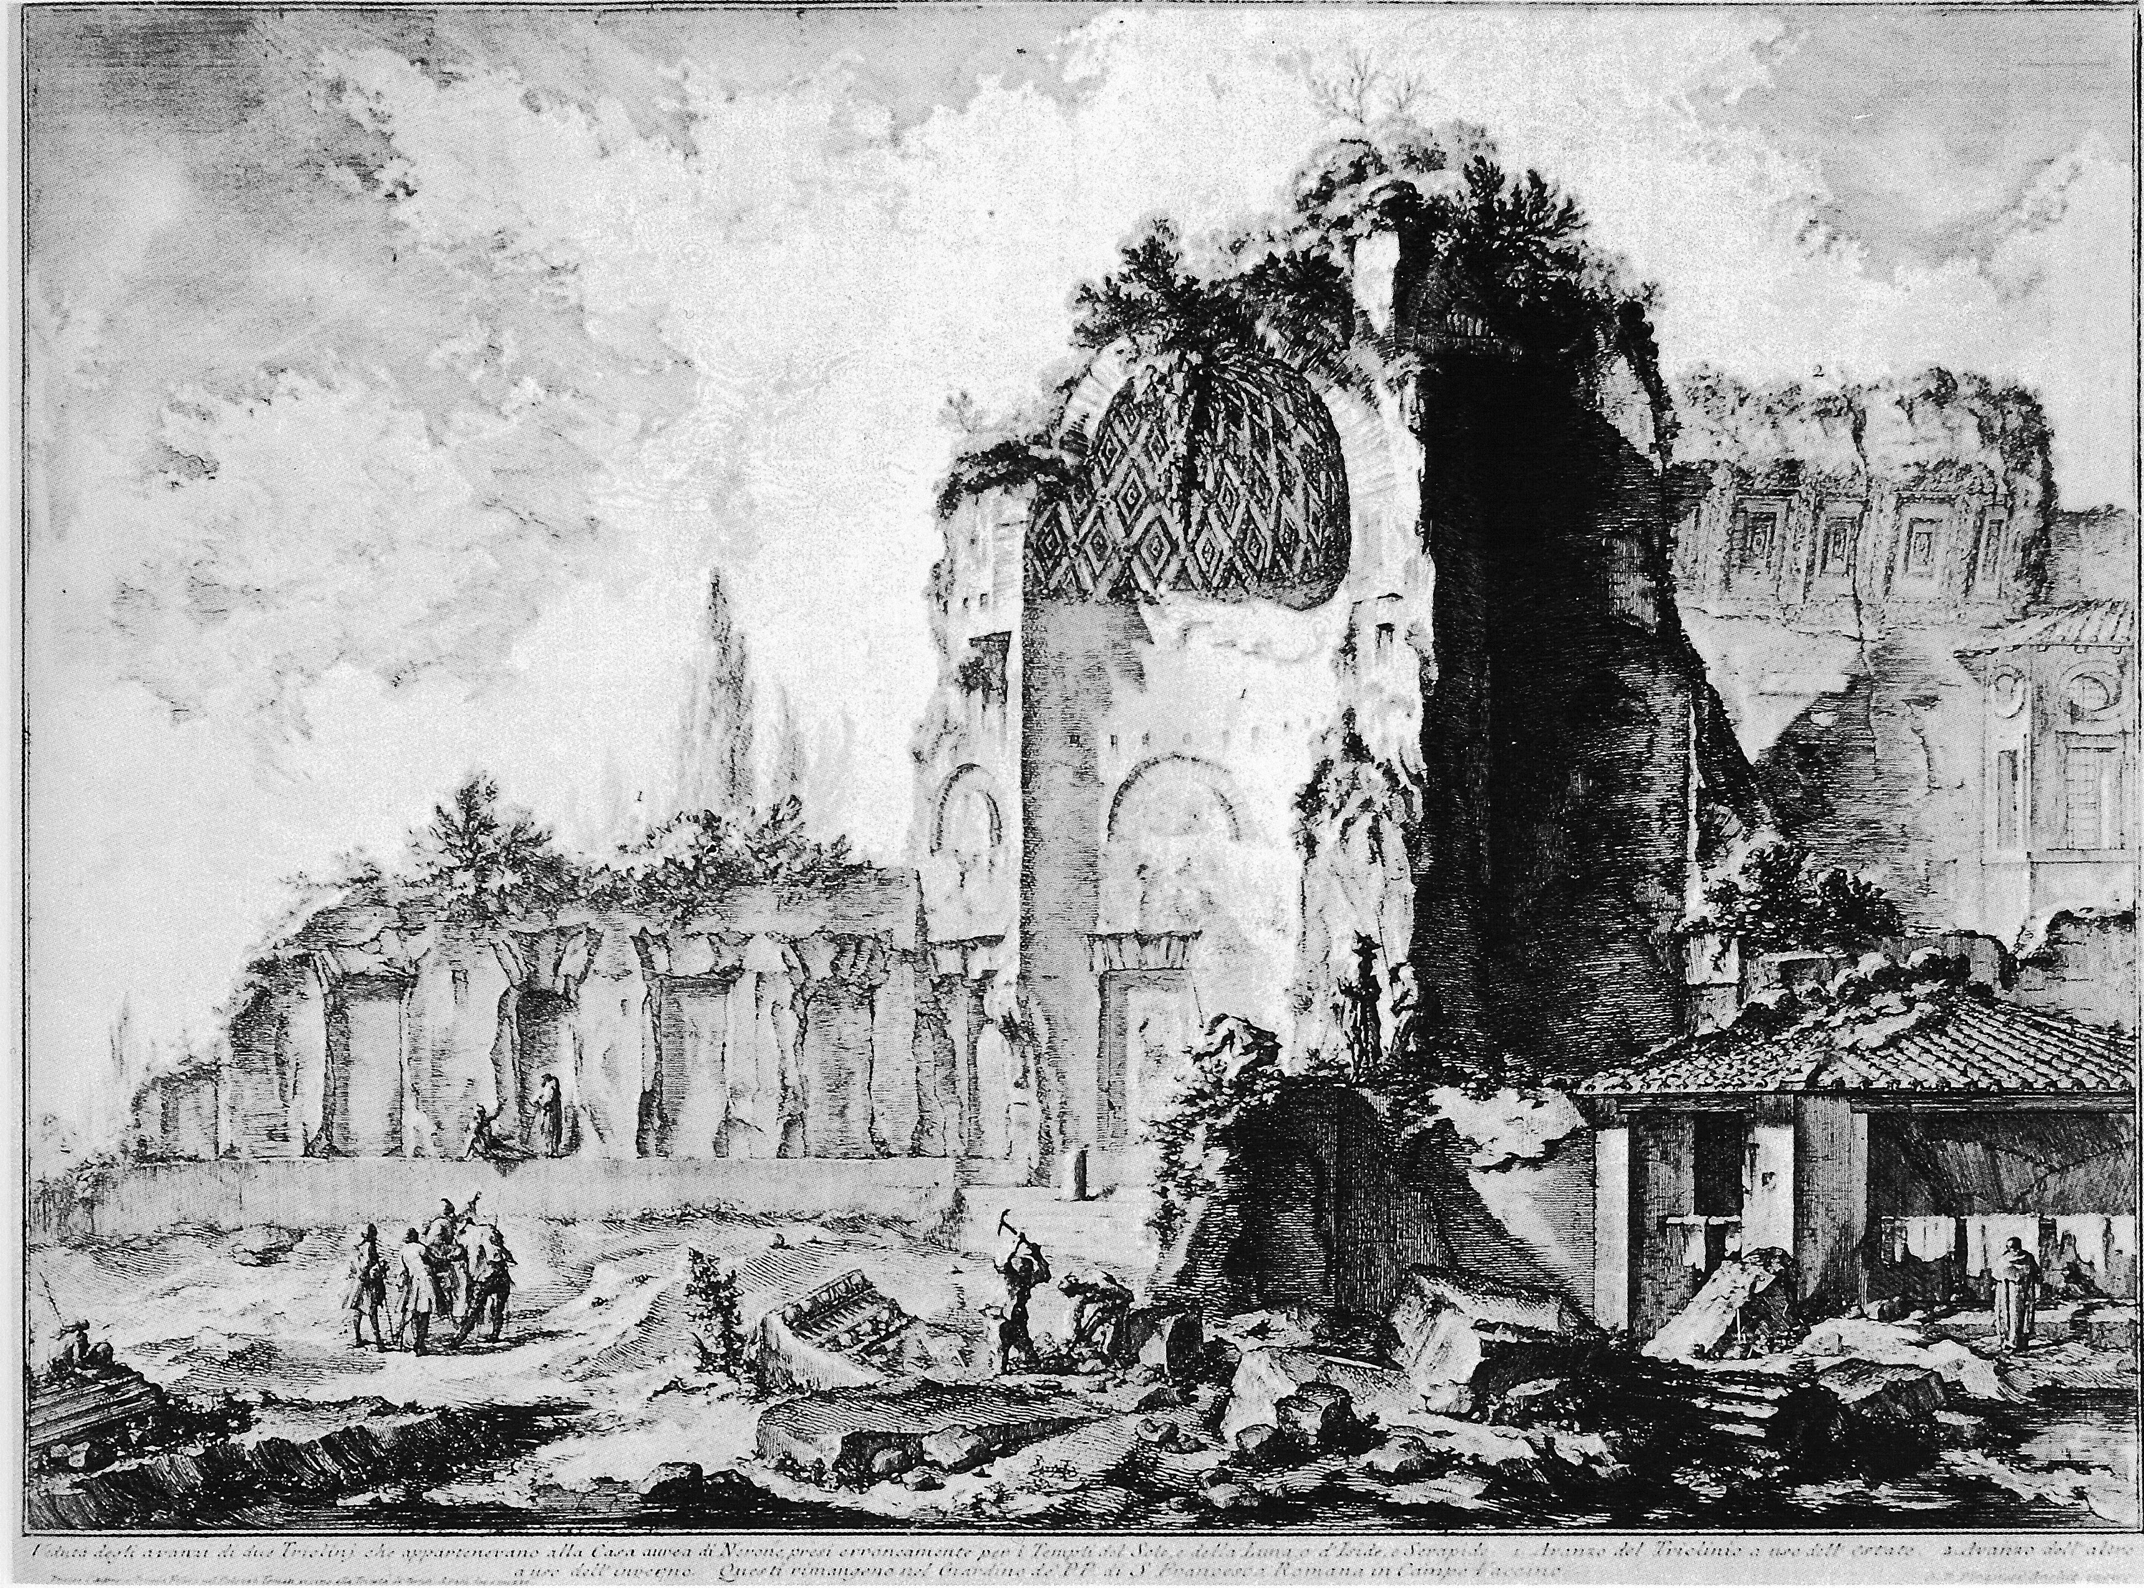
Reconstruction
Or….The United States Part II

Slide 2
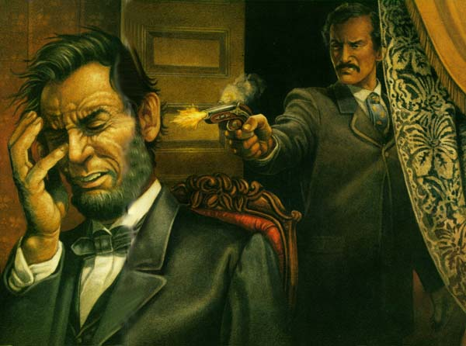
Did I mention that Abraham Lincoln was shot?
I didn’t? Well he was. Sorry, should have mentioned it earlier.

Slide 3

And now the new problem…
Now the problem is “Ok, we won the war. How do we rebuild the country, end slavery, punish the south without destroying their economy and get everyone to get along when no one ever really got along to begin with?”
We will need a plan. In fact we will have three. So? What are the options?

Slide 4
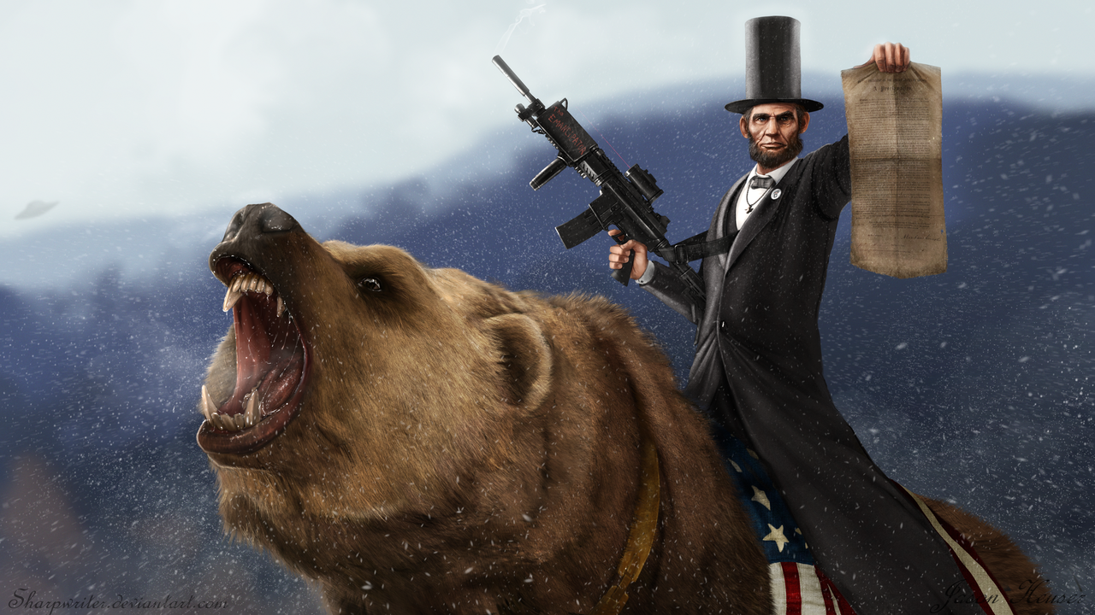
Option 1 Lincoln’s Plan
Before Lincoln had his very bad night out at the theater, he had given some thought to the idea of reconstruction.
His plan? “The Proclamation of Amnesty and Reconstruction” AKA the ten percent plan.
As soon as 10 percent of those that had voted in the rebelling states in 1860 signed an oath of allegiance, the State could be readmitted to the United States.
Pros: It was lenient. Cons: He died before he could make it happen.

Slide 5
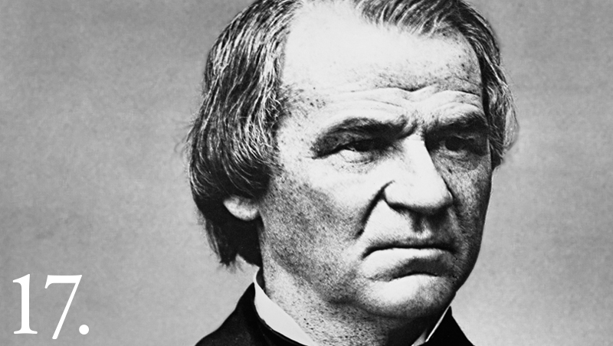
Option 2 Johnson’s Reconstruction Plan
Johnson’s Plan was similar to Lincoln’s. Except for a few minor details. Such as:
Wealthy people would not be allowed to sign the oath, so basically they would lose all political power. He did however pardon 13,000 Confederates so that they could take office and control their states. Johnson did not believe that Blacks should get to vote.
So, Pro: Most people in the South accepted it. Con: It was racist and petty.

Slide 6
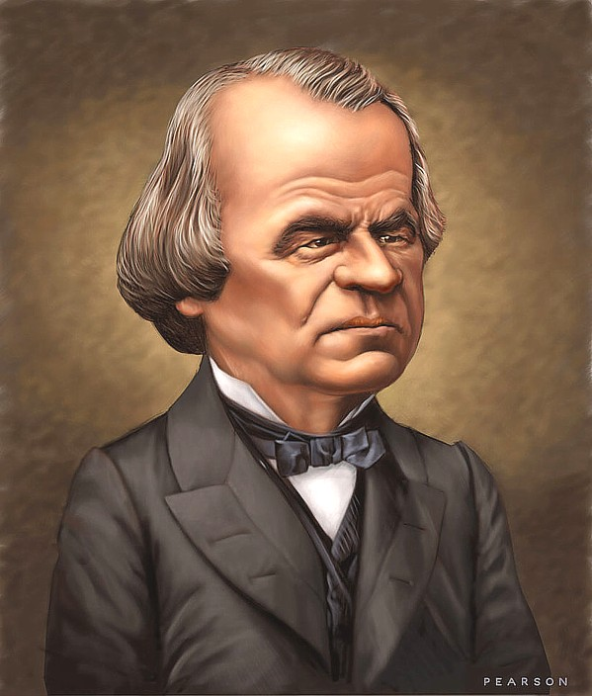
A little more context about Johnson…
As the Civil War was coming to an end the U.S. set up the Freedmen’s Bureau. It created schools, distributed food and clothing and generally helped out former Slaves. Johnson vetoed it because he was a not ok person. Or more specifically he thought it was more than blacks deserved.
Also, the Civil Rights Act of 1866 forbade states from passing black codes. See…https://sites.google.com/a/email.cpcc.edu/black-codes-and-jim-crow/black-code-and-jim-crow-law-examples
Also it gave Blacks citizenship. He vetoed that too. He thought it went beyond the true intent of the Constitution.

Slide 7
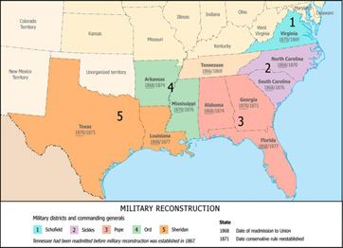
Congressional Reconstruction
Radical Republicans came up with their own plan
First they shifted the task of reconstruction from the executive branch to the legislative.
Then they overrode the President’s vetoes.
They wrote and passed the 14th Amendment
In 1867 they passed the Reconstruction Act of 1867. It specifically did not recognize any new state governments formed under Lincoln or Johnson (except Tennessee). Then the Act divided the South into 5 military districts.
Pros: It was pretty effective at protecting the rights of Blacks
Cons: It ticked off pretty much anyone that lived in the South that happened to be white.

Slide 8
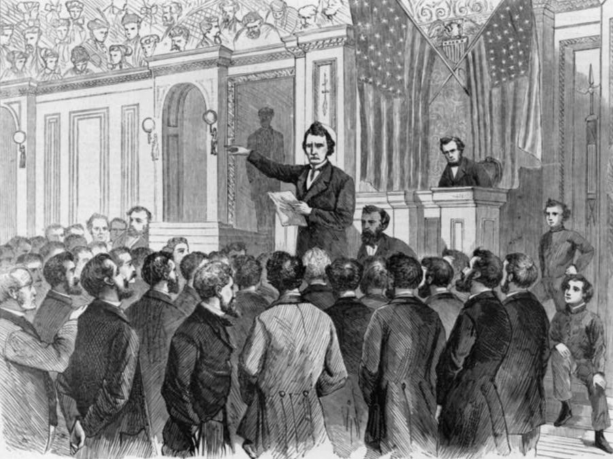
Johnson Gets Impeached
Johnson is getting in the way of Congress, so they look for a way to get him out of the picture.
He is impeached for violating the Tenure of Office Act.
He survives the impeachment process, but he’s pretty much done as President afterwards.
In 1868 Ulysses S. Grant is elected. Also the 15th Amendment is passed.

Slide 9
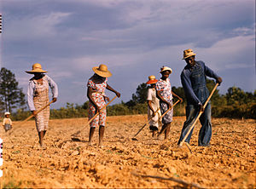
Conditions in the Postwar South
Sucked

Slide 10
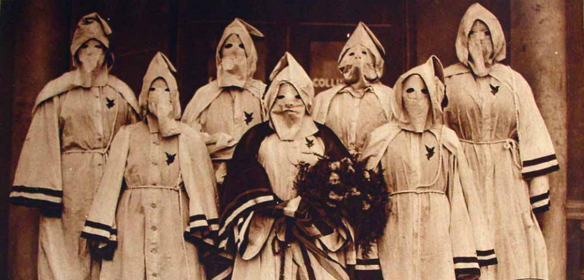
Politics in the Postwar South
Also sucked.
Enter the Carpetbaggers and the Ku Klux Klan

Slide 11
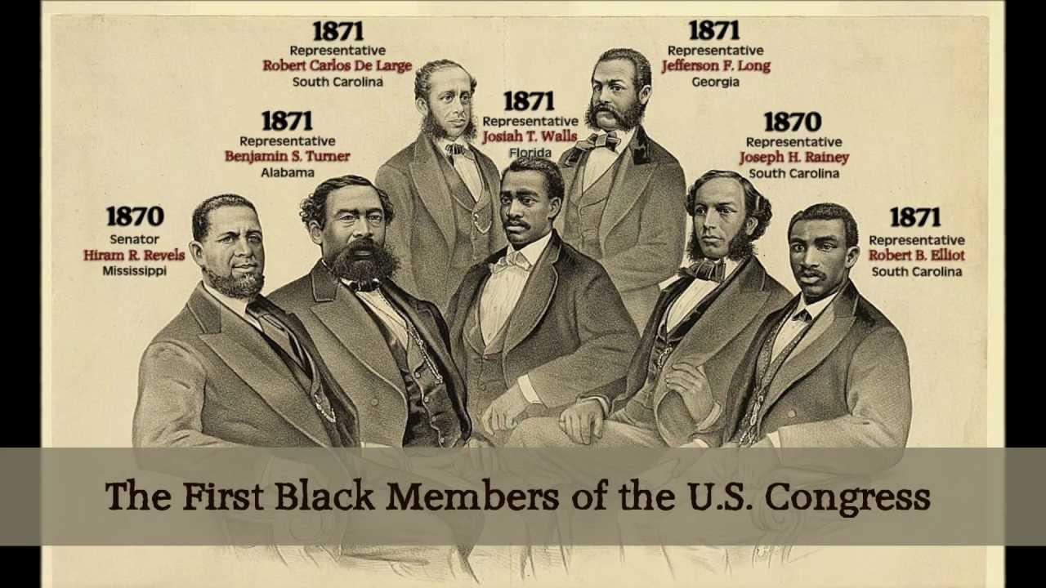
Former Slaves in the South
Things were pretty ok. For a while.
Then they weren’t
At first there were lots of schools and plenty of blacks voting.
A bunch of racist thugs would put an end to that though.

Slide 13
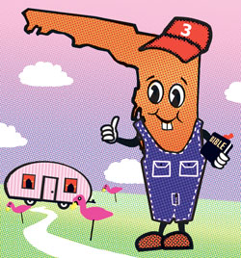
And Finally…The End of Reconstruction
Reconstruction will officially end in 1877
Blacks will lose most of their new rights
The Southern governments or “redeemer” governments will be even more awful if that’s possible to blacks than they were during actual slave times.
The KKK is running around castrating and lynching everyone.
It’s pretty much Florida’s fault because we can’t count.

