Slide 1
deBlij 11.2
How did agriculture change with industrialization?

Slide 2
The Second Agricultural Revolution
First agricultural revolution begins with seed hearths (see Sauer) and the development of agriculture and domestication approximately 14,000-8,000 B.C.E.
Second agricultural revolution takes place between the 17th and 18th centuries with the Columbian exchange making marginal land more productive.
Enclosure Act was passed in Britain encouraging large single-owner holdings.
Farmers increased the size of their farms and used Jethro Tull’s seed drill to plant in rows. (This made it easier to distinguish weeds.)
The second Agricultural revolution made possible the industrial revolution by providing more food, with less labor, allowing part of the labor force to work in industry.
The hearth for the second agricultural revolution was Great Britain, the Netherlands, Denmark and surrounding lands.
Fertilizers and selective breeding made crops more productive and farmers were able to distinguish between cattle that produced high quantities of beef and cattle that produced high quantities of milk.

Slide 3
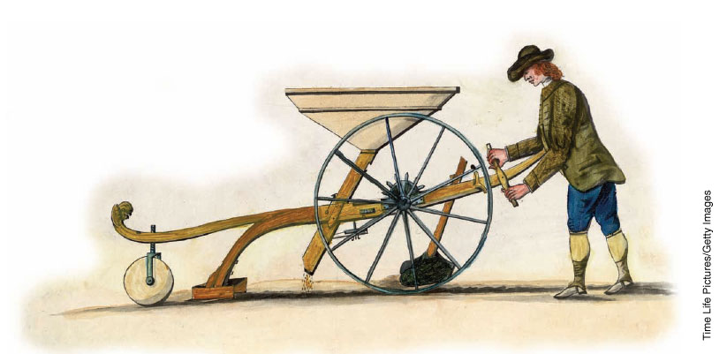

Slide 4
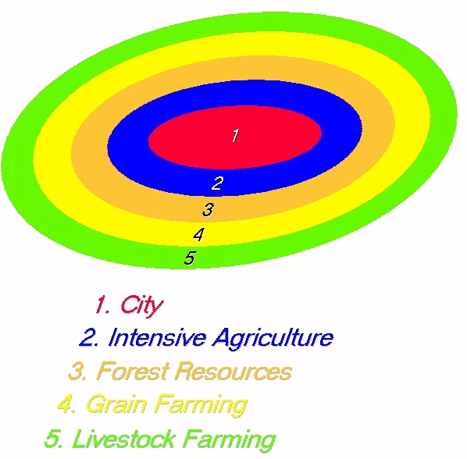
Understanding the Spatial Layout of Agriculture

Slide 5
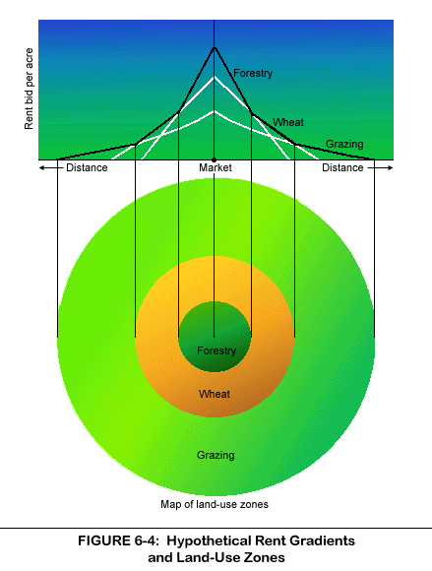
Von Thünen and Land Prices

Slide 6
Key points (assumptions) of the Von Thünen model
All terrain is flat
Soils and other environmental conditions are the same everywhere
There are no barriers to transportation to market
Under this system, transport costs would govern the use of land.
The greater the distance to market the higher the transport costs that had to be added to the cost of production of the crop.
At a given distance it would become unprofitable to produce high-cost perishable commodities.

Slide 7
Analysis of the Von Thünen model
Often described as the first effort to analyze the spatial character of economic activity.
Thünian patterns are displayed world wide, but the patterns are not always the result of forces modeled by Thünen.
Climate and soil type and quality effect the kind of goods produced in a place.

Slide 8
Specific Regional Variations of the Von Thünen Model
In the U.S. (western) dairy and market gardens closer to the center, cash crops such as corn or soybeans at the next ring, extensive grain (wheat) at the next ring, and grazing at the furthest. Different products, but same idea as Von Thünen’s original model.
In China Lee Liu noticed that farmers farmed the land extensively at the inner ring and also at the outer ring, but at the outer ring there was evidence of soil degradation. Farmers are more willing to improve land closer to the village than that further away. At the further rings farmers are more likely to use chemical fertilizers.
The hypothesis is that since Chinese farmers live in villages they are more likely to take better care of land closer to where they actually live.
Beyond the concentric ring theory the underlying cost principal is still evident. Flowers grown in the Caribbean are sold in New York, because it is less expensive, even though flowers could be grown with other methods at different locations.

Slide 9
The Third Agricultural Revolution
The third agricultural revolution is also called the Green Revolution.
In the 1930’s American Farmers manipulated seed varieties to increase crop yield.
In the 1940’s studies were funded to increase corn production in Mexico.
By the 1960’s Mexico was no longer reliant on corn imports.
In the 1960’s research focused on India.
Scientists in the Philippines crossed a dwarf rice with an Indonesian variety to create IR8.
In 1982 IR36 was created from 13 varieties or parents.
The new rice was pest resistant, had a larger grain head, stronger root system to support the larger grain head, resistant to 15 pests, and had a growing cycle of only 110 days making three crops a year possible in some places.

Slide 10
The Green Revolution
By 1992 IR36 was the most widely grown crop on Earth. In 1994 scientists perfected a new strain on IR36 that was more productive.
In addition to IR36 high yield wheat and corn was exported to be grown throughout the world, particularly in South and Southeast Asia.
Most famines today are the result of political instability.
India became self-sufficient in grain production in the 1980’s and Asia as a whole saw an increase of two thirds in rice production between 1970 and1995.
New seed varieties, fertilizers, pesticides and irrigation combined with capital improvements would have a dramatic effect.

Slide 11
And then there’s Africa…
Because of the focus on rice, wheat and corn there has been only a limited effect on Africa that relies on other food sources.
Soil is less fertile in Africa so agriculture is less attractive to foreign investors.
Researchers are working on a “super rice” at the International Rice Research Institute.
High yield cassava and sorghum research has resulted in crops better suited to Africa.
Research continues in North and South America to make fruit more attractive and to fatten animals faster.

Slide 12
Negative Possibilities of the Green Revolution
Increased use of fertilizer
Displacement of small farmers
Destruction of the environment
Pests becoming more difficult to control as they adapt to the new varieties of food.
Helps mostly agribusiness at the expense of small, or poor farmers.

Slide 13
Genetically Modified Foods
The U.S. leads the world in the production of genetically modified food.
38% of all acres of corn and 80% of all acres of soybeans are grown with genetically modified crops.
Ideological resistance particularly in Western Europe.
Many nations lack the capital to invest in GMOs.
Cultural resistance in places where grain and seed production is part of the lifestyle and change would affect the daily way of life and generational knowledge of seed cultivation.

Slide 14
Regional and Local Change
Changes from subsistence agriculture to commercial has had dramatic effects in some areas.
In Latin America there has been a noticeable increase in cash crops.
Subsistence farming is pushed to more marginal land and the wealth involved in agriculture has made it increasingly susceptible to political pressure.
The change from subsistence to agriculture to high yield cash crops has created unexpected results in relationships between men and women.
Land that was cultivated by women as a subsistence producing area has been converted to cash crops.
When rice production became a year round occupation many women found no time left for other household chores.
In Sub-Saharan Africa 85% of all women work in agriculture.
In China 75% of women work in agriculture and in India 70% of women work in agriculture.

