Slide 1
Things I Would Rather Be Doing
A short rant by Timothy Petraitis
Followed by a lesson on Population

Slide 2
Things I would Rather Be Doing
Lining up elephants
Training an aardvark
Sitting perfectly still
Procrastinating actually making a power-point
Balancing large objects on smaller objects
Pretending my pencil was a rocket ship
Avoiding an alien abduction
Learning to recognize different fruit flies just by their emotional facial expressions
Etc. etc.

Slide 3
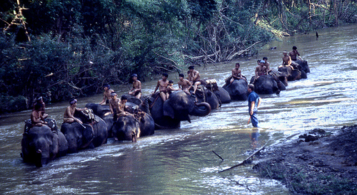
And Now Your Tax Dollars at Work!
I actually had a little time to do the first bullet on the previous slide.

Slide 4
Who’s Winning
India
India will overtake China by 2050
India and China are still growing but the natural increase is higher in India. It’s not the highest in the world but it’s high enough to overtake China.
Southeast Asia is growing (generally) but they have a smaller population overall. Indonesia, Thailand and Vietnam are declining.

Slide 5
Back to Population at Regional Scale
South American Growth is declining
The slowest growing countries-including those with declining rates of natural population increase-lie in the economically wealthier areas of the world.
Russia is a whole other story.

Slide 6

Russian Population Decline

Slide 7
Generally
The higher the rate of urbanization the lower the natural increase.

Slide 8

One Sad Story
India-Wow. You just don’t do that.
Seriously, Uttar Pradesh. Guns for sterilization? How does that even make sense?
Ok, it makes sense a little bit.

Slide 9

At Least He’s Sterilized

Slide 10
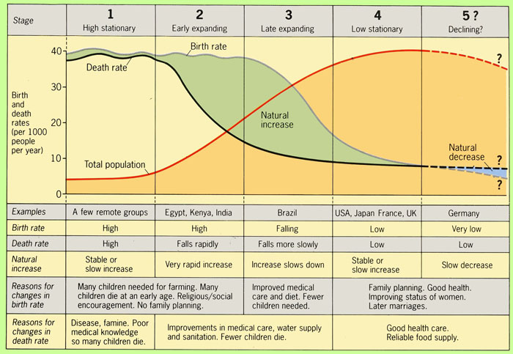
And NOW! The Demographic Transition Model

Slide 11
Be Forewarned…
You will be responsible for explaining the Demographic Transition Model and why it grew the way it did.
Tomorrow: Disease Death and the Government.
Today: Pyramid Project. (With technology)

Slide 12

Even More Fun

