Slide 1
KEVIN JIMENEZ! IF YOU FALL ASLEEP DURING THIS LESSON IT WILL NOT GO WELL FOR YOU!
I AM NOT GOING TO STAY UP HALF THE NIGHT TO WORK SO I CAN WATCH YOU SLEEP THE NEXT DAY!
(I’m not mad, just disappointed. You used to be cool. What happened?)

Slide 2
What Imprint Does Agriculture Make on the Cultural Landscape?
That’s the question. Normally this would be on the first slide, but I was too angry with Kevin to do that. So there you go Kevin. You wasted the title slide. Are you happy? Do you even feel emotions? Do people without souls have feelings? Tell me Kevin. Tell me what it’s like being an empty flesh puppet devoid of what makes the rest of us human.

Slide 3
This slide will have no mention of Kevin Jimenez and his tendency to ignore the hard work of others. We have wasted too much time on him already.
Your book says “Flying from the West Coast of the United States to the East Coast, if you have a window seat, you will see the major imprint agriculture makes on the American cultural landscape.” What it doesn’t say is that if you have the middle seat you will miss all of this and will probably just see the upholstery of the seat in front of you. Maybe you will see the leering face of a toddler as he gazes down at you as he stands backwards in his seat, deciding if he wants to just stare at you or perhaps vomit. You can never tell with toddlers.

Slide 4
What you would see out the window of that plane…
You would see: Green circles. Pivot irrigation.
Also: A checkerboard pattern. This is the cadastral system. Cadastral systems of settlement occur in places where settlements can be regulated by law.
What you see in the Western U.S. is the rectangular survey system.
This was adopted after the U.S. Revolution and is part of a cadastral system known as township and range system.
The basic unit of this system was one square mile section. It was then sold as whole, half, or quarter sections. Homesteads were 160 acres and were adopted in 1862 for a fee of 30 dollars, five year residency and improvements to the land.

Slide 5
French America and Real America
The term French America is almost an oxymoron, but it is one that we have to come to terms with. There was a time that the French instituted their insidious system of land measurements called long-lot survey systems. Unlike real Americans, the French believed in the pseudo-communist belief that the means of getting to market should be shared by all and not just dominated by the strong (the real Americans).
French America is the Canadian (figures) Maritimes, Louisiana and parts of Texas. I’m assuming Maine got in on this as well. Anywhere they settled like a plague (of frogs?).
Then there is the Metes and Bounds systems. That is basically the way the first settler East of the Appalachians determined their boundaries. Sentences like the following were not uncommon: “You see that rock that looks like the butt of a hippopotamus? That’s where my farm ends.”

Slide 6
Primogeniture
Germanic
Common to northern Europe
Northern European settlement areas
The Americas, South Africa, Australia, New Zealand
Parcels tend to be larger and a farmers work a single plot of land.
All land passes to the first born.
When land is passed to multiple heirs fragmentation occurs. This results in smaller plots of land. You would expect this on Indian reservation lands, Asia, Africa, and Southern Europe.

Slide 7
Villages
In the periphery traditional farm life is still evident. In India, Sub-Saharan Africa, China, Southeast Asia, most of the population is involved in agriculture.
In the core the percentage of people involved in agriculture is much less. For example in India approximately 70% of the population is involved in agriculture, while in the U.S. it has fallen to less than 2%.

Slide 8
Villages…the drama continues.
Traditionally in Japan the houses in farming villages are very close together. This means that every square foot of growing space can be used. The life of everyone in the village was tied to the land through one process of agriculture or another. (nucleated settlement)
In the U.S. the farmhouses are spread much further away. This is dispersed settlement. The difference is not in the intensity of the land use but often the technology used. In the U.S. the use of machines in agriculture allow a dispersed settlement pattern.

Slide 9
And now…MORE VILLAGES (and hamlets)
Hamlets are small.
Villages are larger (but still pretty small).
In Europe the villages are often on hills. This leaves the flat land available for farming.
In low-lying areas of Europe the villages take on a linear pattern if they lie on dikes and levees.
The European Version of the East African circular village with a central corral for animals is called a rundling. Yep, a rundling. Try working that into your next dinner conversation. First used by Slavic herdsmen and later modified by Germanic settlers.
Walled villages had walls. Sometimes lots of them.
Grid villages were more common to Spanish settlement and Spanish colonial villages. Other colonial powers followed and this is now pervasive in middle America and in Africa.

Slide 10
More
Half of the world’s population still live in villages and rural areas.
As total world population increases, total populations in villages and rural areas goes up.
This occurs even if the total proportion of the people in rural areas or villages is in decline.
In China more than 60% of 1.3 billion people live in villages or hamlets. In India with over 1 billion people 70 percent of the population lives in non-urban areas.
NAFTA has created less farm jobs in Mexico, yet as the total population increases, more people are living in rural areas and villages, but are finding other methods besides agriculture to make a living.

Slide 11
Functional Differentiation Within Villages
Social stratification
Africa
India (caste-system)
Protection of livestock and storage of harvested crops is the main function of an agricultural village. Some of the best and most carefully constructed buildings in a village (particularly in subsistence farming) are dedicated to this purpose.

Slide 12
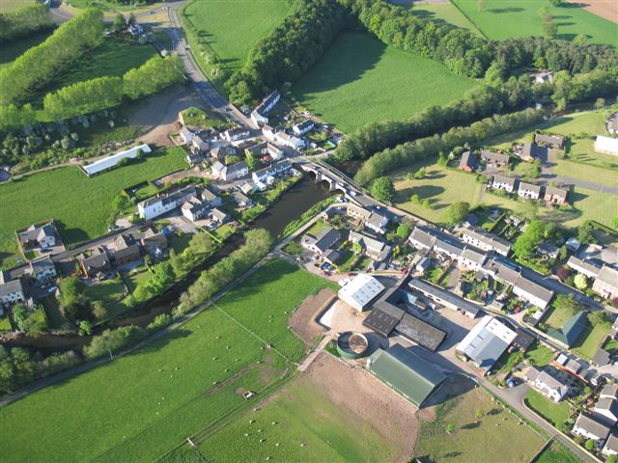
Linear Village
Eamont Bridge, England

Slide 13
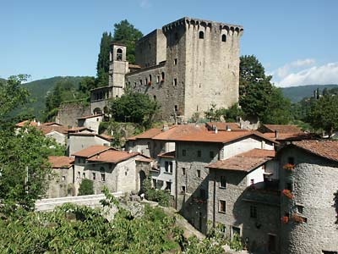
Cluster Village
Villa Rosa Italy

Slide 14
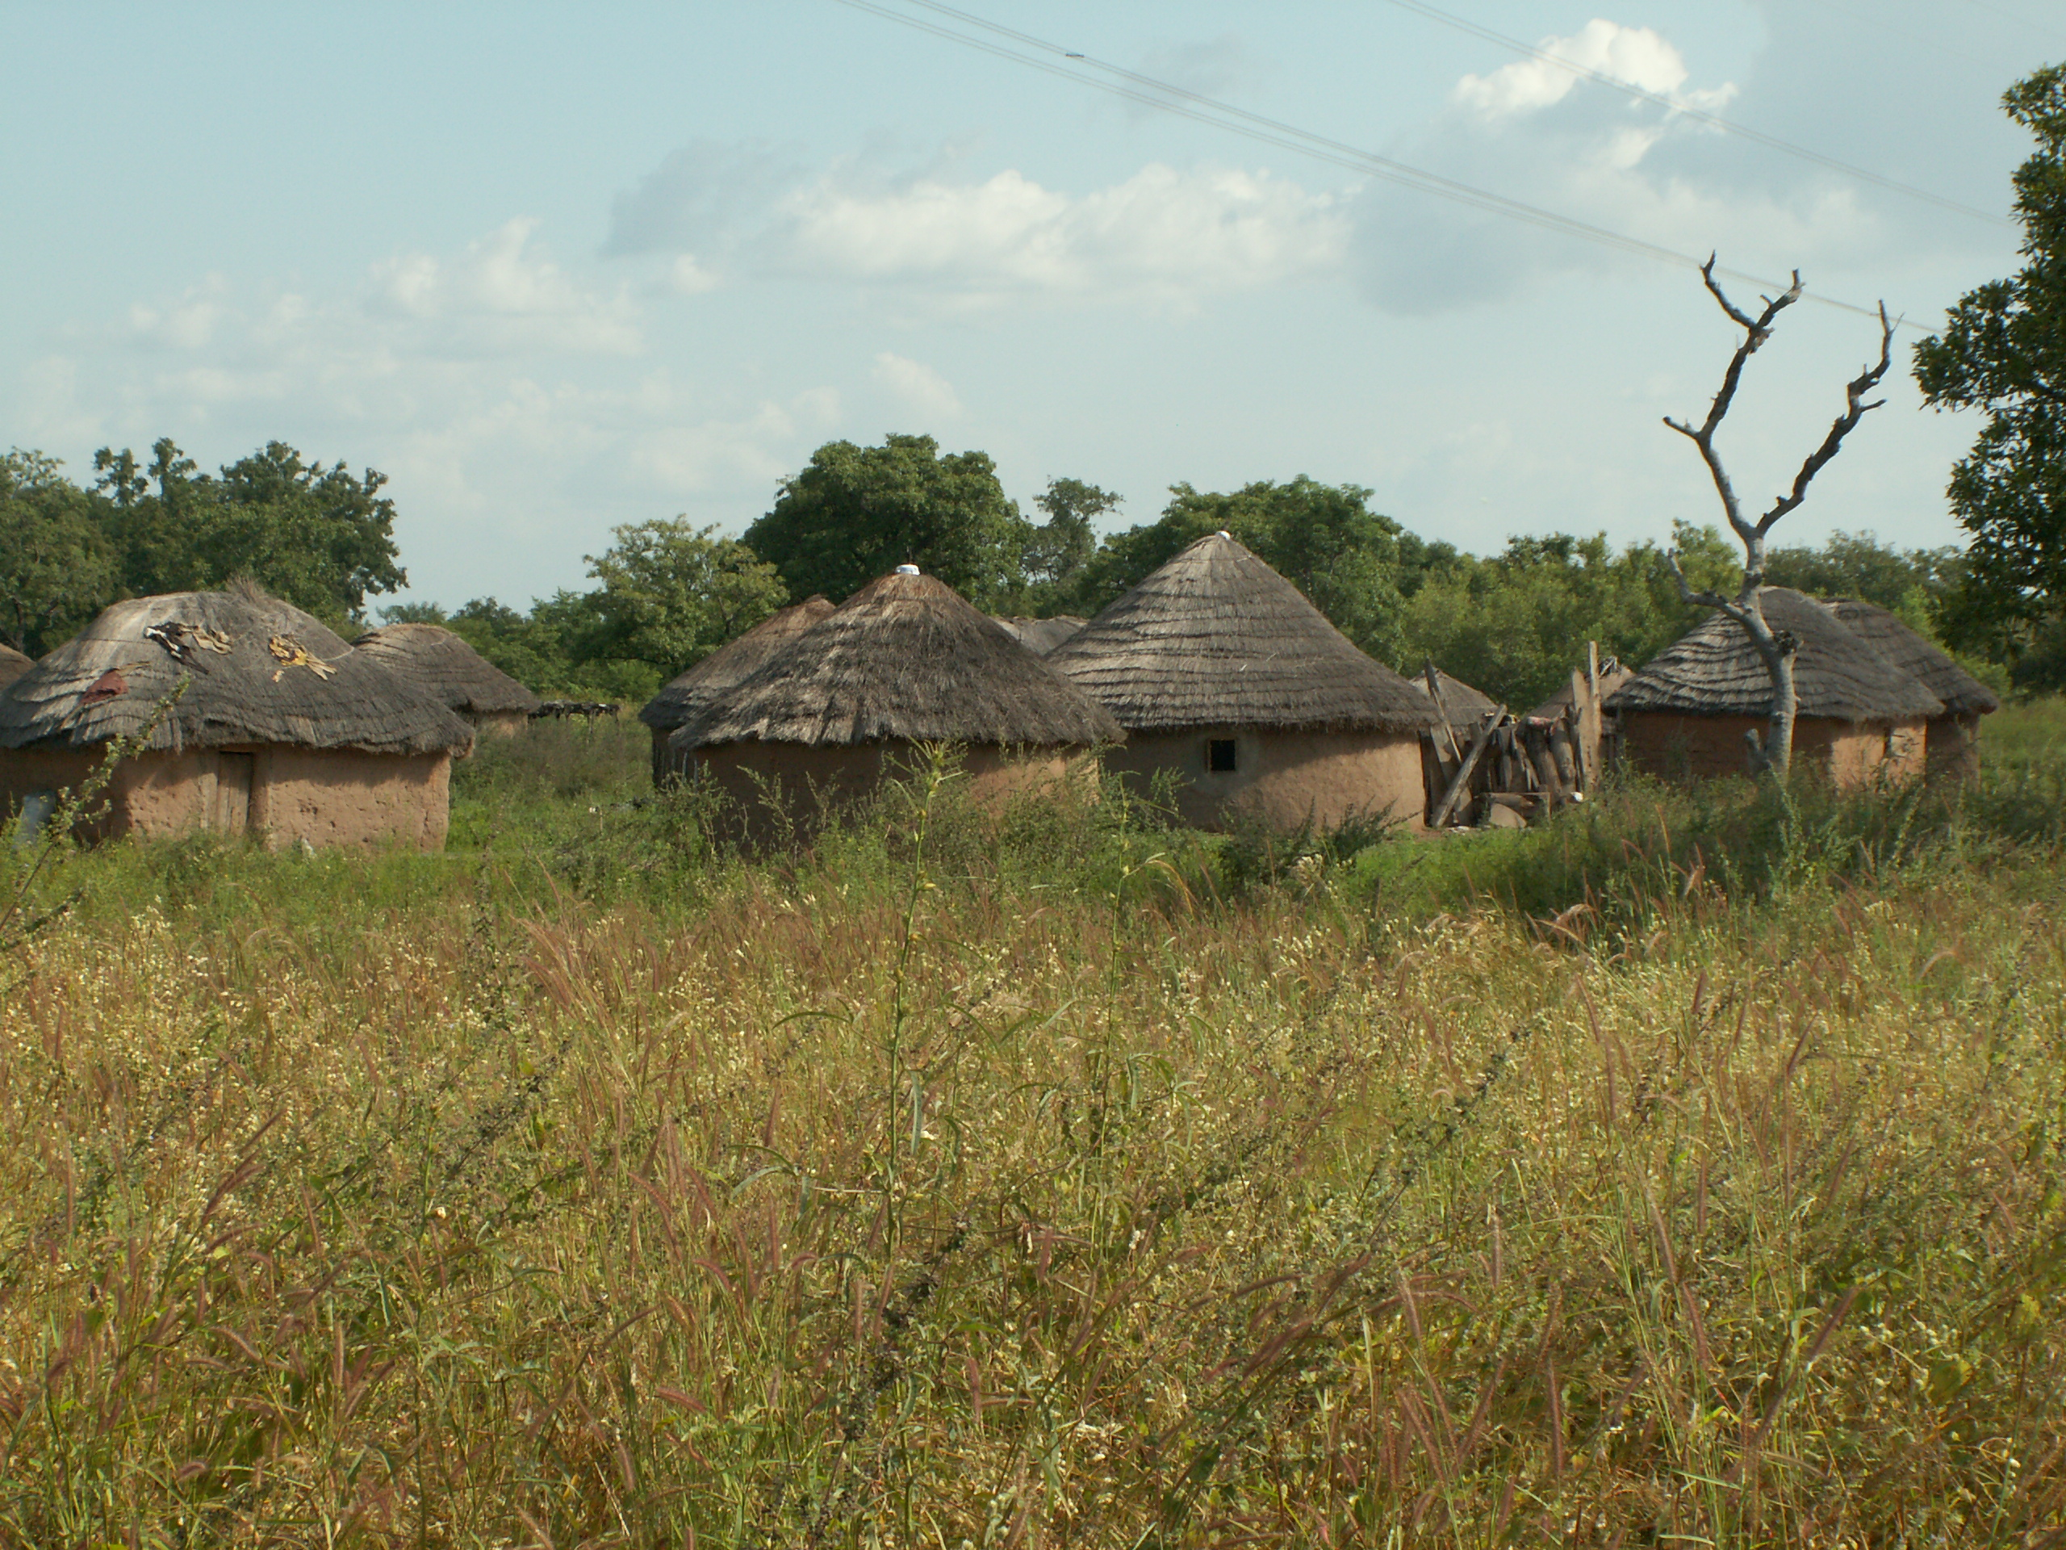
Round Village
Ghana

Slide 15
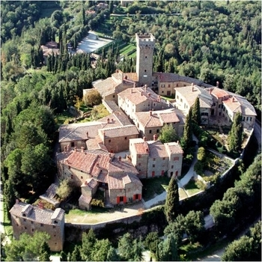
Walled Village
Castello di Gargonza, Italy

Slide 16
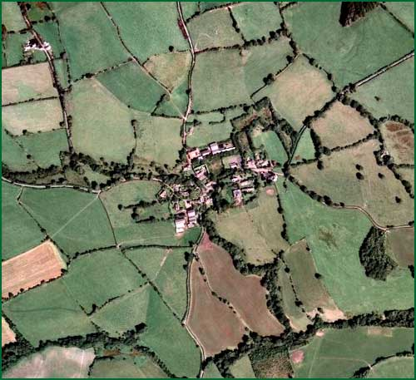
Grid Village
Picklescott, England

Slide 17
It’s over.
Wake up Kevin.

